Slide 1
Navigating the “Known Unknowns”
State of the Economy
January 2025
CBEA RESEARCH ANALYST FELLOWS
Maille Cannon
Evan Paque
Jaden Propson
Marc Schaffer, Ph.D.
Professor, Economics & Data Analytics
Executive Director, CBEA
Prepared for
Estate Planning Council of Northeast WI

Slide 2
Overview
1
Economic growth
The United States Economy grew at 2.8% in 2024. This moderate growth was driven through consumer spending specifically on services & durable goods. This stable growth is expected to continue into 2025
2
Labor Markets
The labor market continue to soften as unemployment was consistent at relatively low rates throughout the year. The labor force participation rate shows signs of a new normal.
3
Inflation
Global and domestic economic factors, including key indicators like housing, wages, supply chains and policy will determine future inflation trends and economic movements in 2025, but for now inflation is near target range, albeit slightly elevated
4
Housing
Housing prices likely to remain elevated in the midst of limited supply, vacancy, along with affordability challenges due to elevated mortgage rates.
5
The ”Known Unknowns”
Economy is on solid ground according to the Federal Reserve and monetary policy is in a holding pattern with rates in the face of the known unknowns
Fiscal and Trade policies are the key known unknowns that will play a role in shaping the economy in 2025

Slide 3
Overview
1
Economic growth
The United States Economy grew at 2.8% in 2024. This moderate growth was driven through consumer spending specifically on services & durable goods. This stable growth is expected to continue into 2025
2
Labor Markets
The labor market continue to soften as unemployment was consistent at relatively low rates throughout the year. The labor force participation rate shows signs of a new normal.
3
Inflation
Global and domestic economic factors, including key indicators like housing, wages, supply chains and policy will determine future inflation trends and economic movements in 2025, but for now inflation is near target range, albeit slightly elevated
4
Housing
Housing prices likely to remain elevated in the midst of limited supply, vacancy, along with affordability challenges due to elevated mortgage rates.
5
The ”Known Unknowns”
Economy is on solid ground according to the Federal Reserve and monetary policy is in a holding pattern with rates in the face of the known unknowns
Fiscal and Trade policies are the key known unknowns that will play a role in shaping the economy in 2025

Slide 4
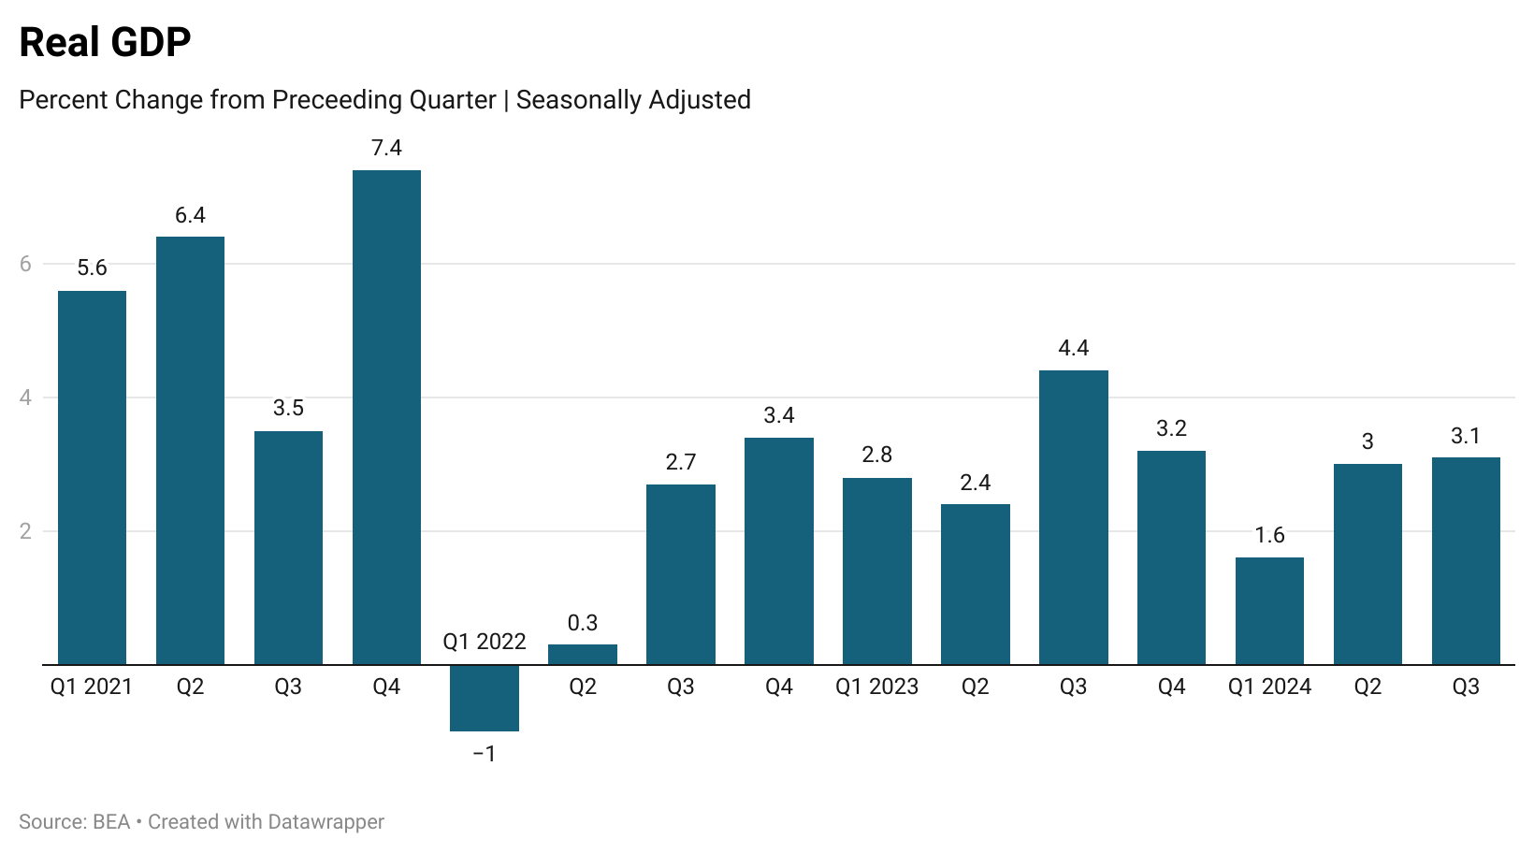
In spite of headwinds, real GDP has continued its resilient growth and is expected to end 2024 with 2.8% growth for the year.
Notes:
-Real GDP has increased throughout 2024 at 3.1% in quarter 3. This strong increase is mainly due to consumer spending and investments
Gdp3q24-3rd.xlsx
Big headwind: continued high interest rate environment
2022 average 2.5%, 2023 average 2.9%, expected 2.8% growth

Slide 5
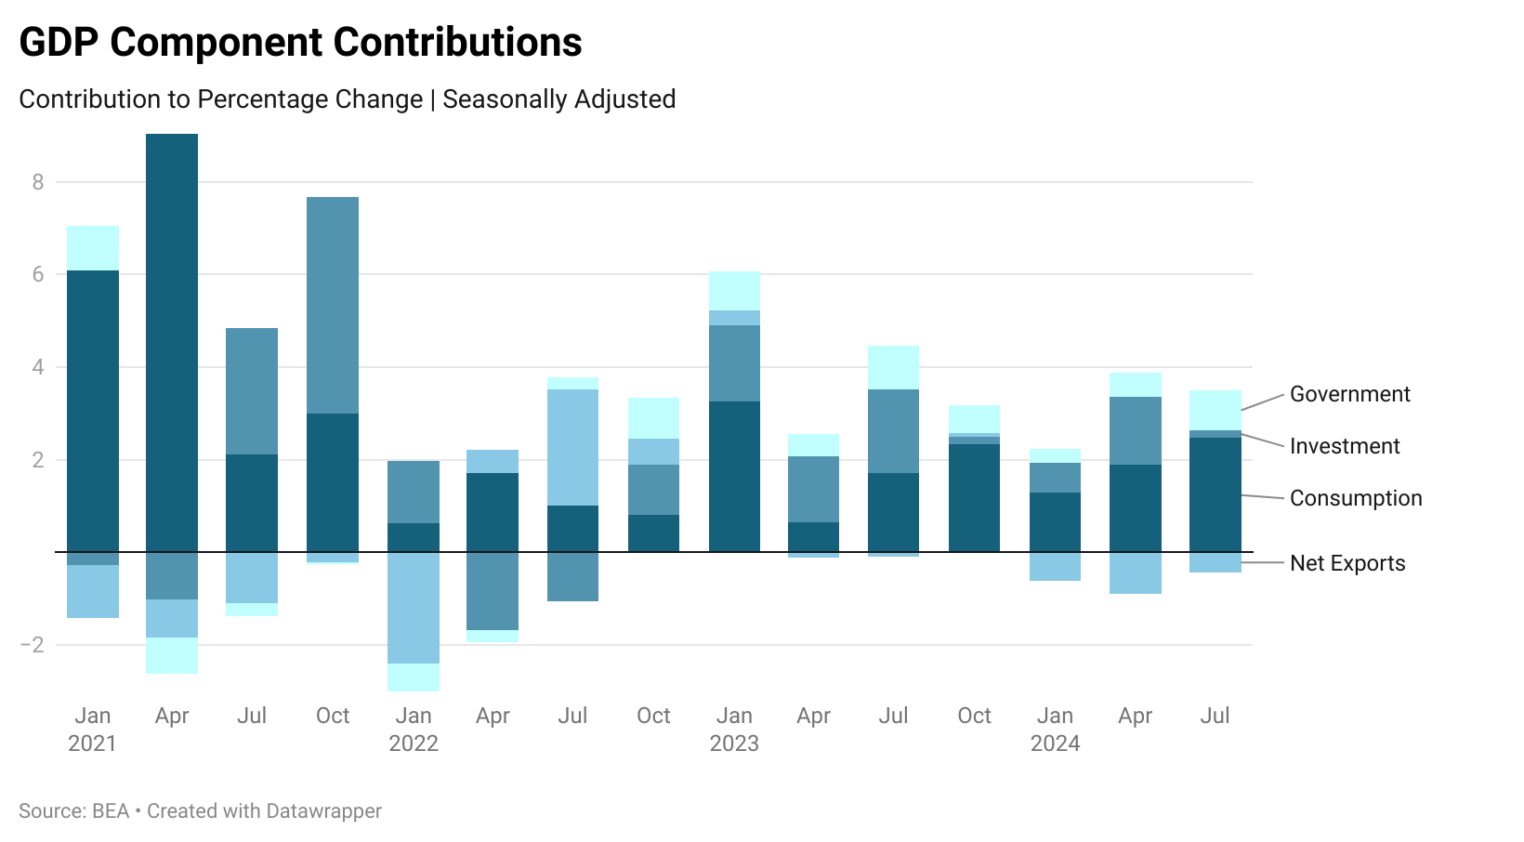
Consumer resiliency continued to drive the economic growth in 2024…
Notes:
-Consumption saw the largest increase throughout the year at 3.7 in Q3
-Investments saw a decrease relative to the previous period at .8
-Government saw an increase at 5.1. This was mainly due to the increase in national defense spending which was 13.9
Comments from October presentation – referencing Q2
When we break out Real GDP into its contribution components, we see the main contributors to the increase in Real GDP are consumption and investments. Consumption has been a substantial contributor to GDP since Q2 of 2022 and saw a large spike in the beginning of 2023. Consumption has been pretty steady in terms of its contribution to GDP in the past year.
The investment side of GDP seemed to spike this quarter in comparison to the previous, this is because there was a build up in inventory investments, meaning we saw lots of production overall this quarter, and a surplus of supply.
Consumption and investment together helped contribute to the 3% increase in GDP. Continuing gains in consumer spending is driven by a growing income, relatively.

Slide 6
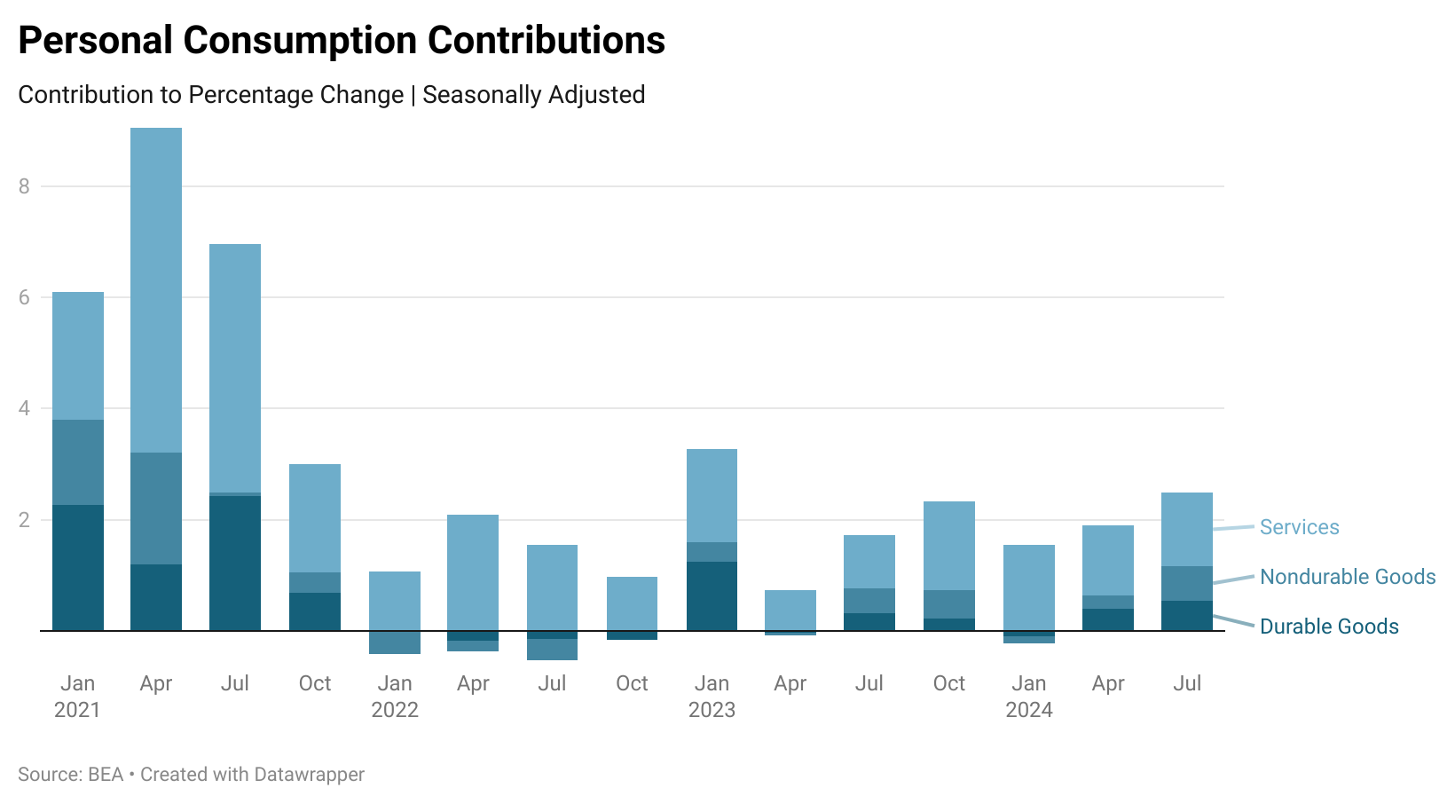
Consumer spending on services drove this resiliency, while durable and non-durable goods spending increasing throughout the year
Notes:
-Services increased throughout the year showing that healthcare held its highest increased at .79
-Nondurable saw a strong increase in Q3 led by prescription drugs along. Durables increased in the motor vehicle and furniture sectors. An increase in durable spending signals an increase in consumer confidence.
To further break down Real GDP, to see where this increase is coming from, in regards to consumption, the three main categories are durable goods, nondurable goods, and services.
Durable goods are those that are typically kept for a period of time, such as furniture, appliances, and cars. Non durable goods are those that are more fastly consumed, such as food, groceries, and clothing.
We are seeing an uptick in the consumption of durable goods, which is the opposite as we saw in 2022. We can see in the graph that durable goods contributed negatively, or not at all to consumption during this time. durable goods spendign was so low in 2022 because spendign spiked in 2020/2021 as we could not go out and spend on services. This is why we saw no durable goods spending in 2022, as durable goods last a few years. now, it makes sense this component has increased, as we are replacing these goods

Slide 7
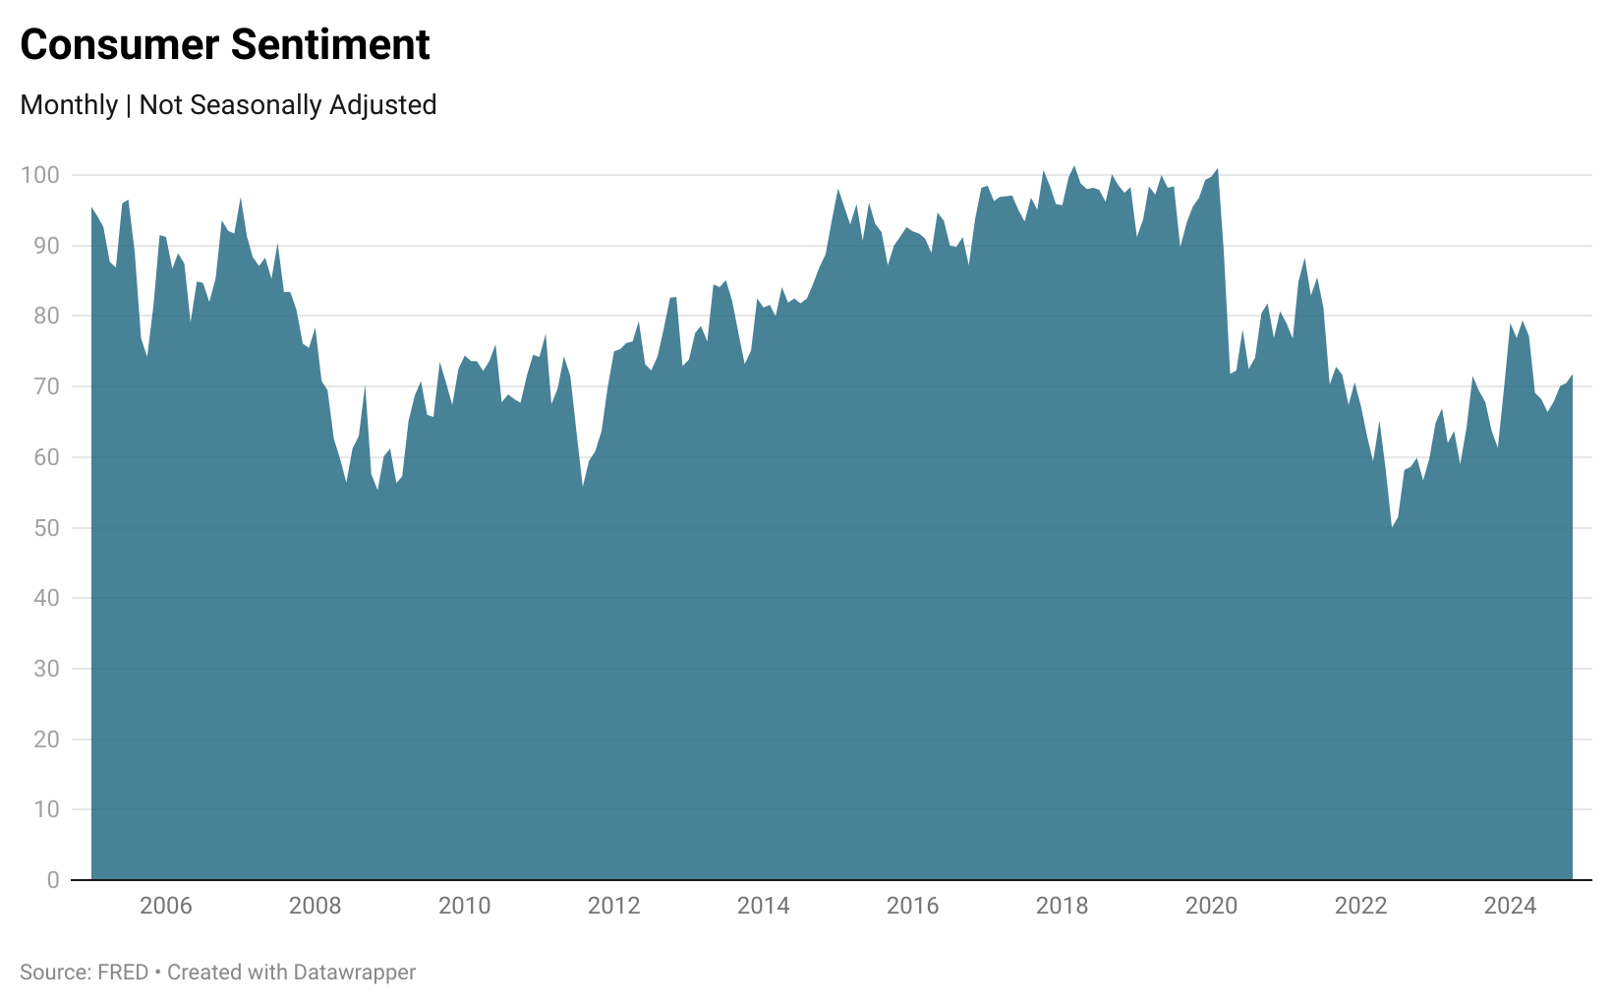
Consumer sentiment shows positive overall trend after falling in in the first half of the year suggesting some optimism, but still lagging pre-pandemic sentiment
Notes:
-Compared to the 2020 high of 101, 30 below.
- 2020 to 2024 we see a gradual increase
-In January, consumer confidence was sitting at 79, after falling to around 66 in July, we see a shallow uptick entering into 2025.
4Q 2024 CFO Signals survey | Deloitte Insights

Slide 8
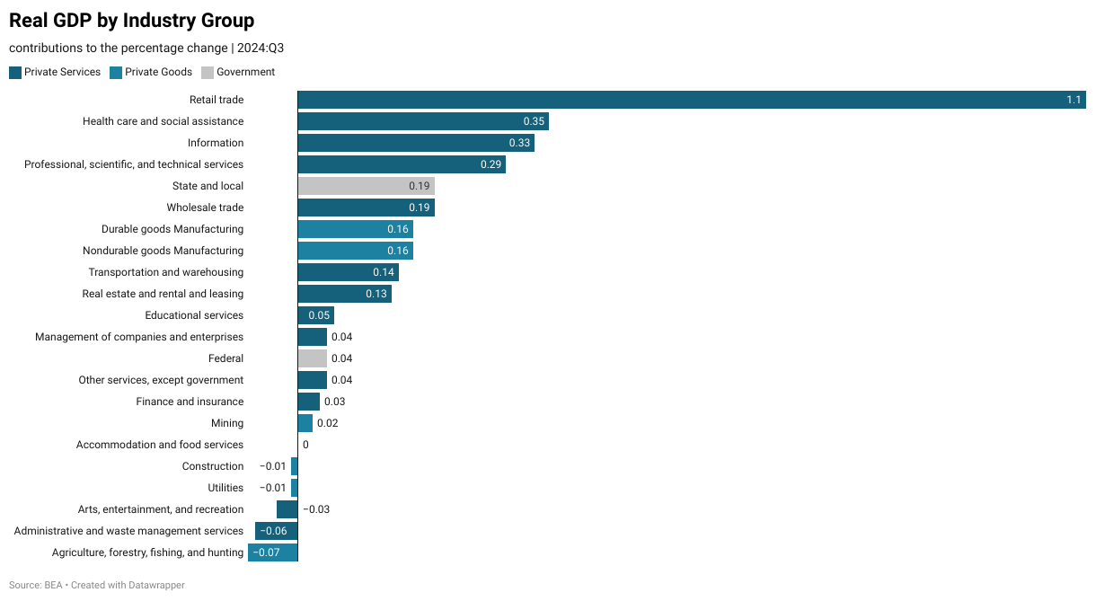
Private service industries contributed the most to growth with retail trade, healthcare, & information leading the way
Notes:
-Compared to the 2020 high of 101, 30 below.
- 2020 to 2024 we see a gradual increase
-In January, consumer confidence was sitting at 79, after falling to around 66 in July, we see a shallow uptick entering into 2025.
4Q 2024 CFO Signals survey | Deloitte Insights

Slide 9
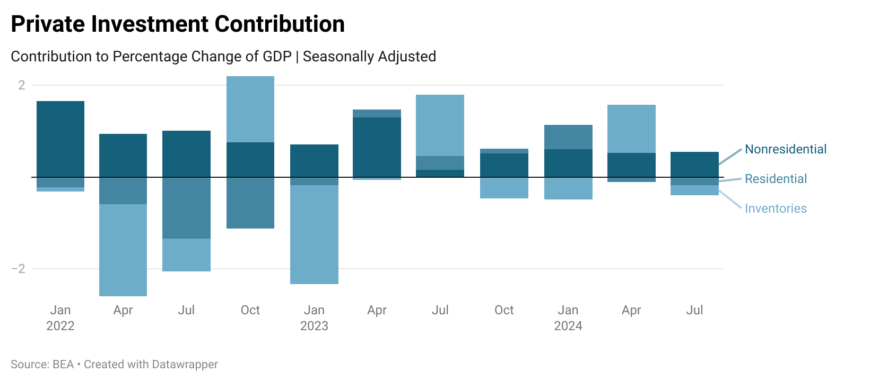
Private inventories and residential investment dragged on the GDP investment growth in Q3
Notes:
-Non residential has remained consistent throughout 2024; equipment large.
-residential has decreased -0.18.

Slide 10
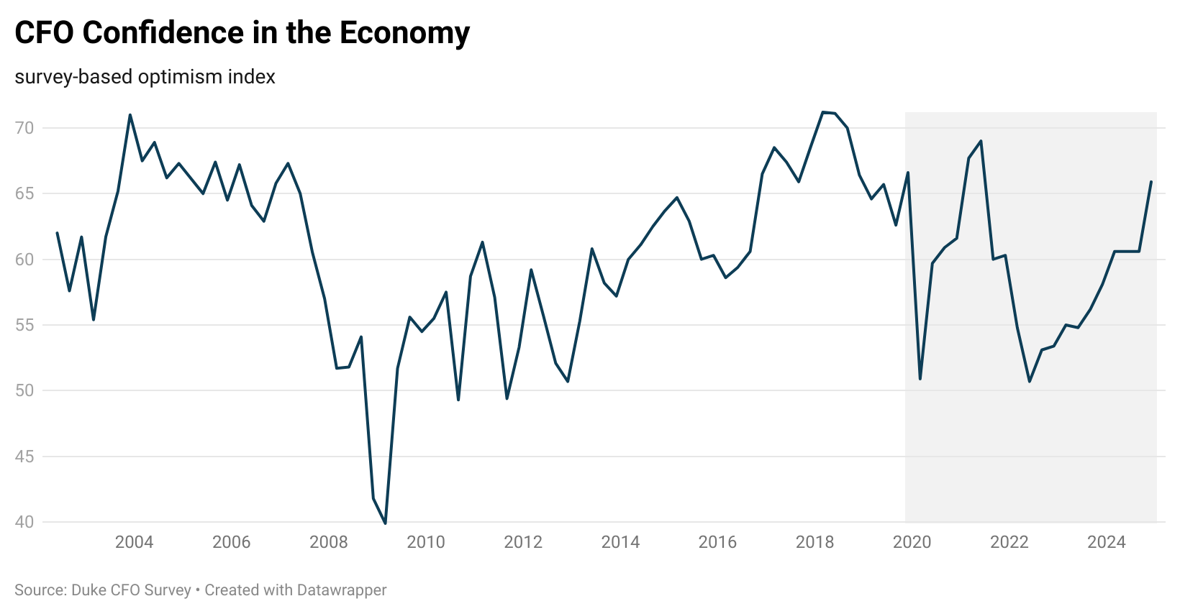
CFOs continued to gain confidence in the economy…
Notes:
-Non residential has remained consistent throughout 2024; equipment large.
-residential has decreased -0.18.

Slide 11
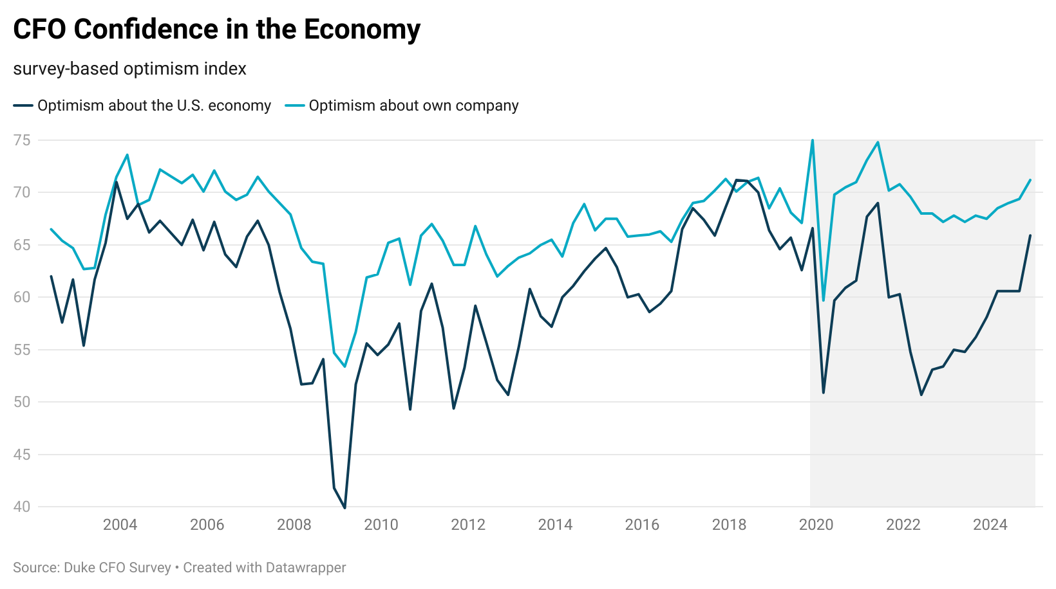
… as well as optimism in their own firms
Notes:
-Non residential has remained consistent throughout 2024; equipment large.
-residential has decreased -0.18.

Slide 12
Overview
1
Economic growth
The United States Economy grew at 2.8% in 2024. This moderate growth was driven through consumer spending specifically on services & durable goods. This stable growth is expected to continue into 2025
2
Labor Markets
The labor market continue to soften as unemployment was consistent at relatively low rates throughout the year. The labor force participation rate shows signs of a new normal.
3
Inflation
Global and domestic economic factors, including key indicators like housing, wages, supply chains and policy will determine future inflation trends and economic movements in 2025, but for now inflation is near target range, albeit slightly elevated
4
Housing
Housing prices likely to remain elevated in the midst of limited supply, vacancy, along with affordability challenges due to elevated mortgage rates.
5
The ”Known Unknowns”
Economy is on solid ground according to the Federal Reserve and monetary policy is in a holding pattern with rates in the face of the known unknowns
Fiscal and Trade policies are the key known unknowns that will play a role in shaping the economy in 2025

Slide 13
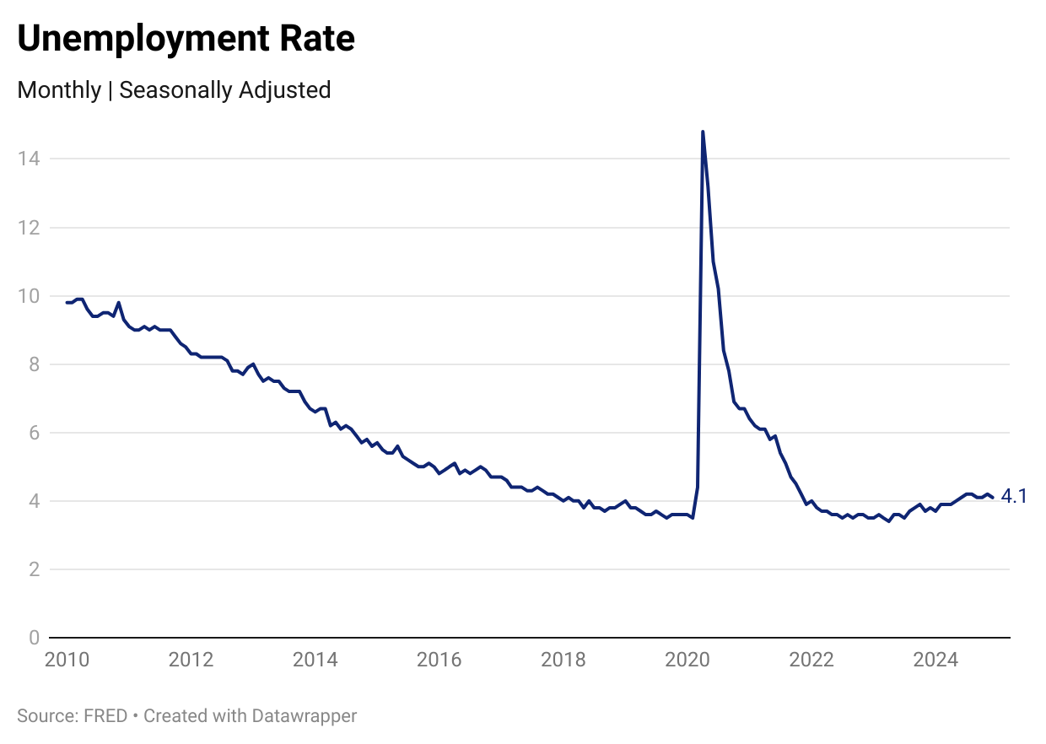
Unemployment Consistently Sits Around 4.1% During the Second Half of 2024
Notes:
Unemployment Rate rose by .5% throughout 2024. sitting round 4.1% in the second half of the year. Hasn’t been this high since November of 2021

Slide 14
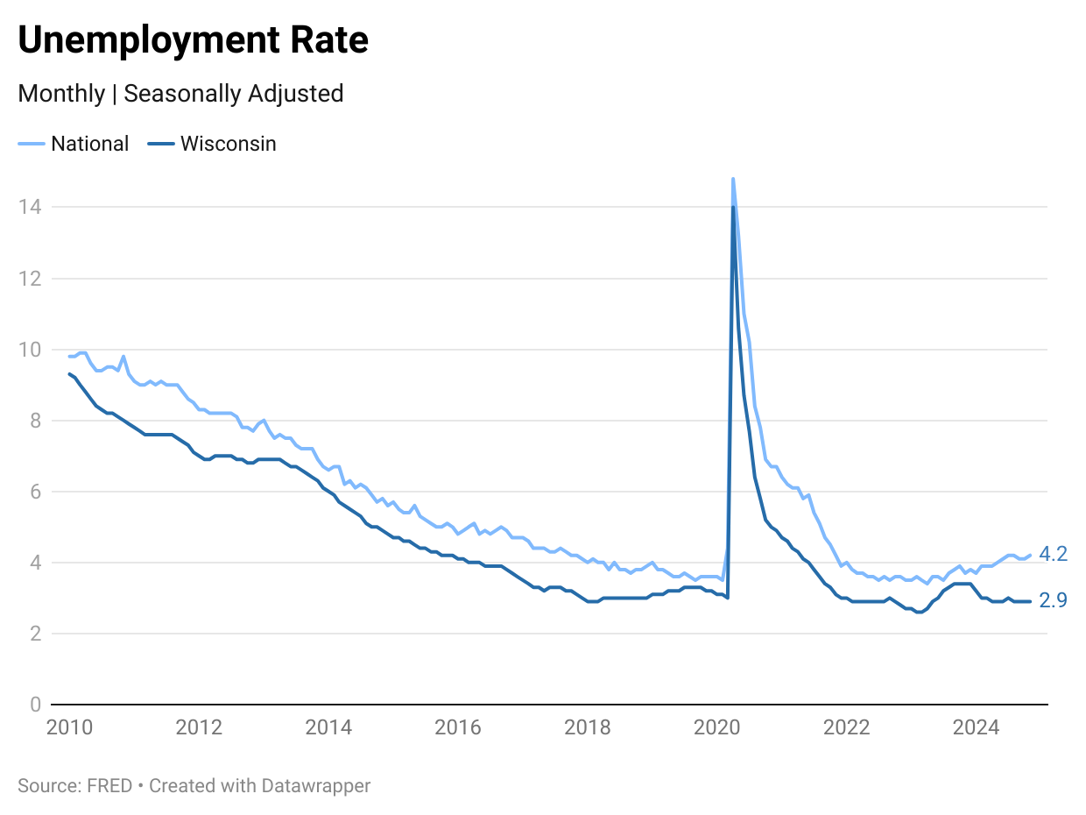
Wisconsin Unemployment Remains Significantly Lower than National Unemployment Level
Notes:
Wisconsin's Unemployment rate dropped from 3.2% in January.

Slide 15
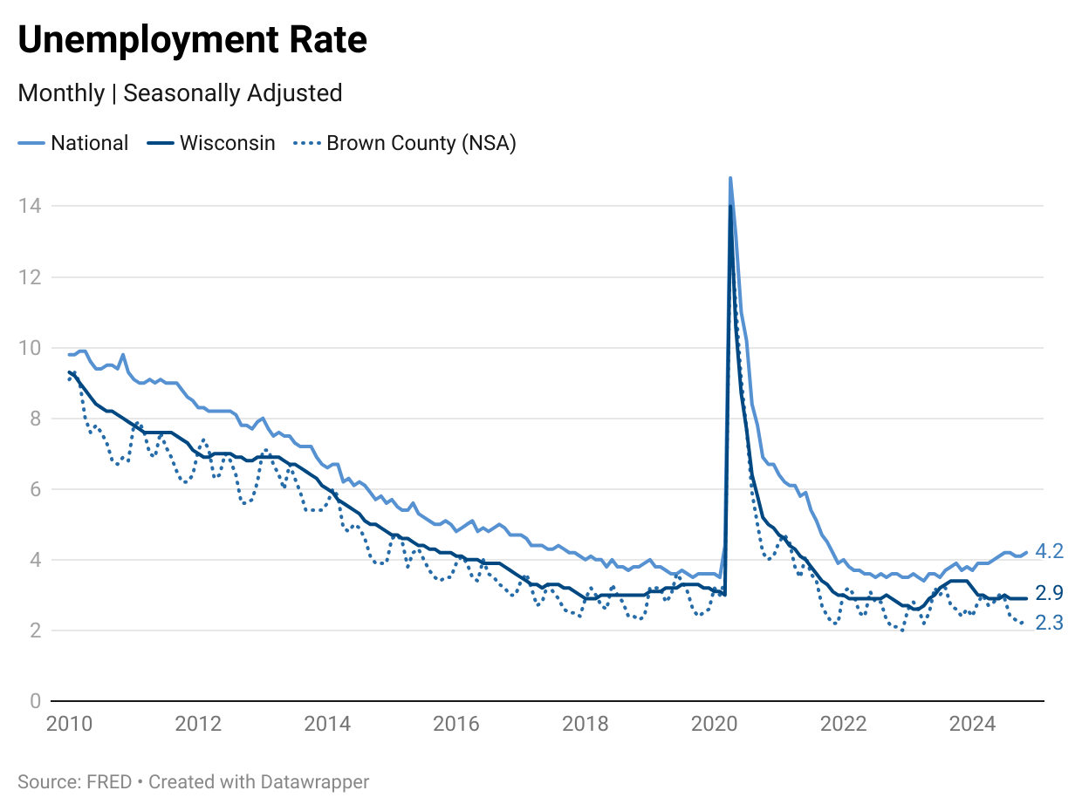
Unemployment Rate in Brown County Decreased at the End of the Year
Notes:
*goes to november

Slide 16
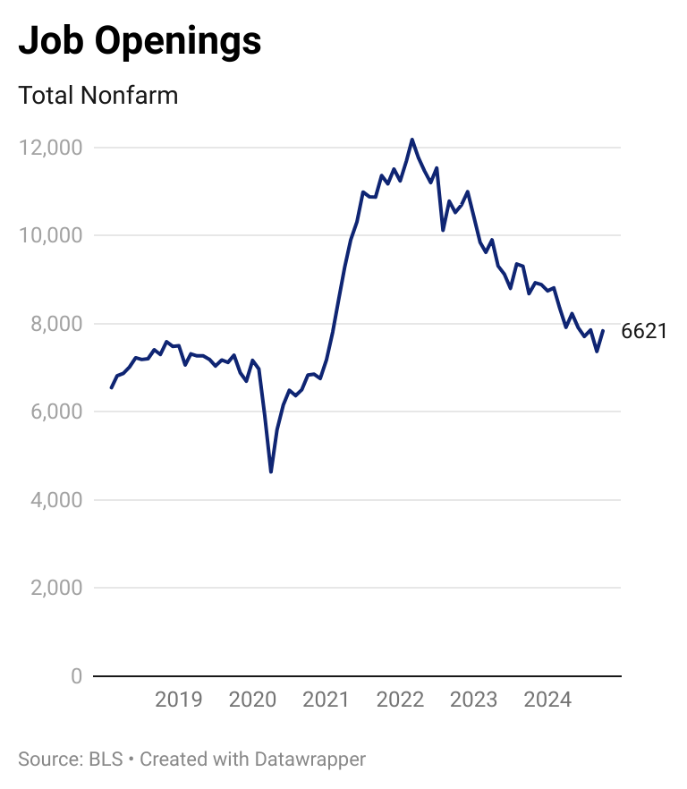
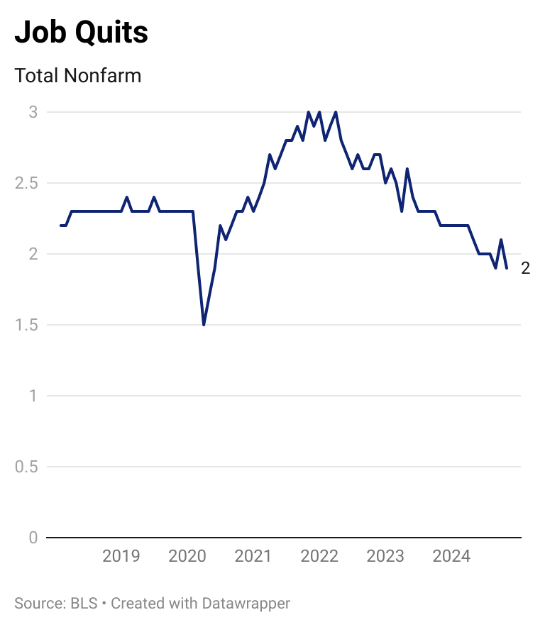
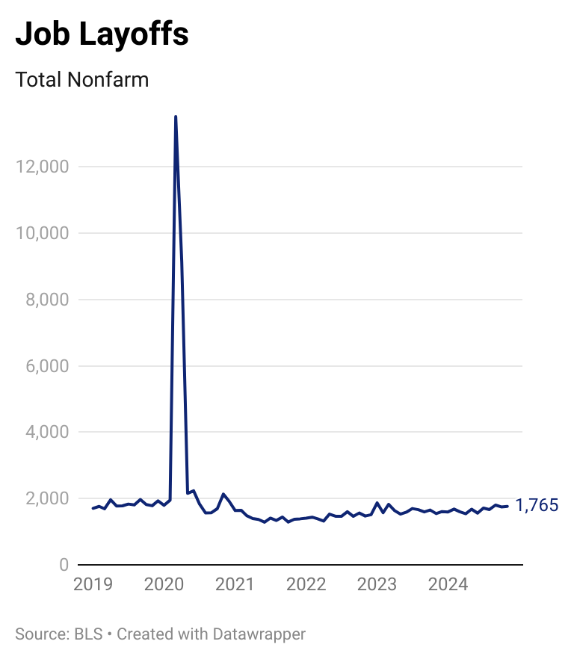
Job Openings and Quits Have Previously Shown Signs of the Great Resignation But Have
Normalized Since
Notes:
-Job openings, quits, and layoffs have held steady throughout the year.
-Job openings and quits have been on the decrease since 2022.
-Job quits have surpassed pre pandemic levels while job openings are still approaching

Slide 17
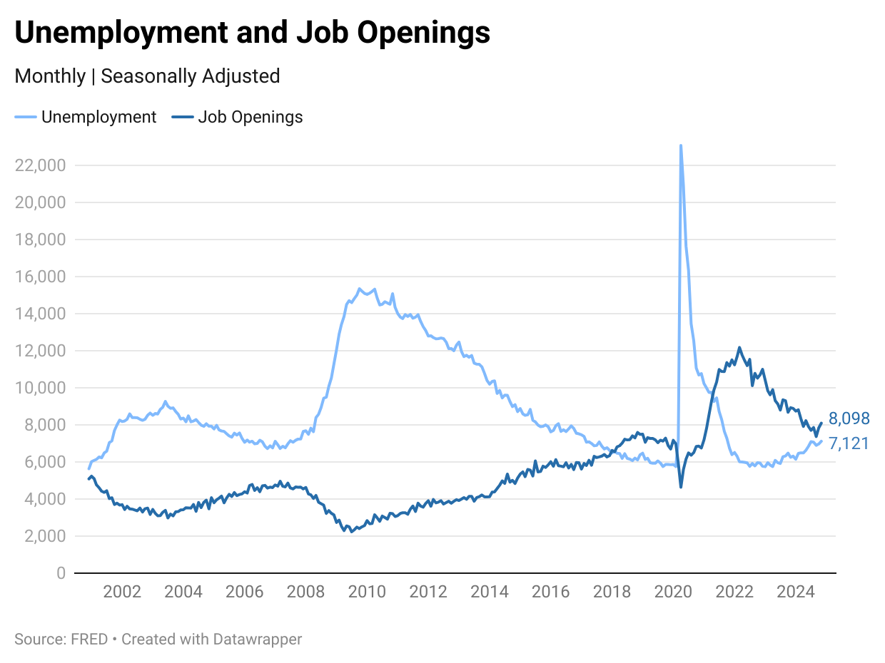
Labor Market is Closing Relative to Unemployment and Job Openings Comparison
Notes:
-Labor market gap is closing entering into 2025.
-In 2020 the unemployment rate was higher than jobs available in the market. Entering into 2022, there is a shift where there are more jobs available thank people unemployed. *ratio
Number of unemployed persons per job opening, seasonally adjusted

Slide 18
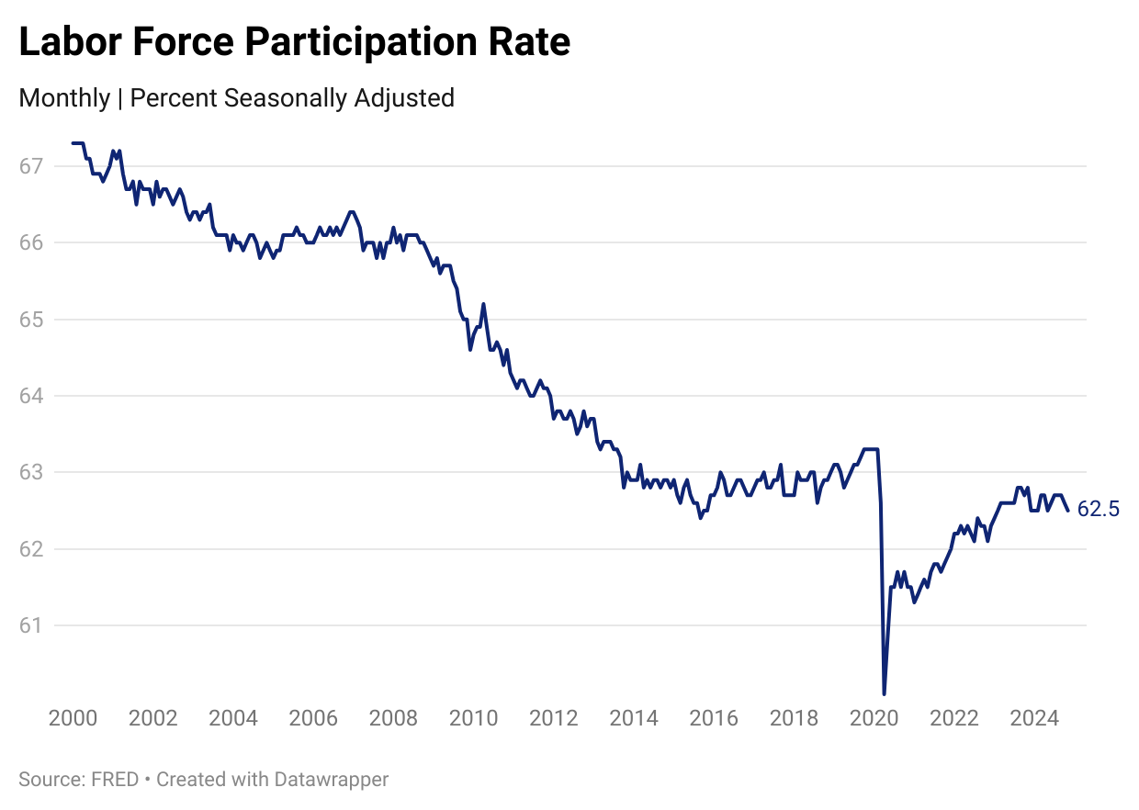
Labor Force Participation Rate Shows New Normal
Notes:
Prior to Covid-19, the labor force participation rate was sitting around 63%. After increasing throughout 2021 to 2023, the Labor Force Participation Rate has held steady around 62.5% this year.
New normal caused by age and immagration

Slide 19
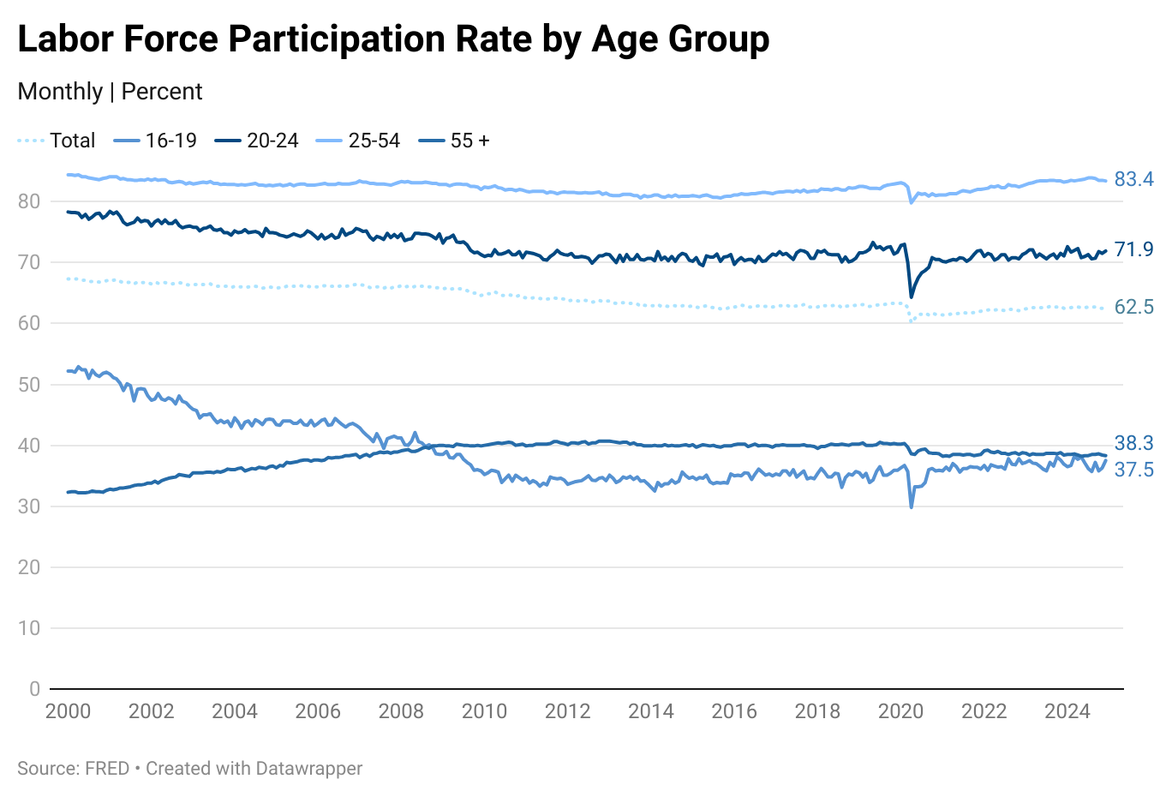
Labor Force Participation Rate by Age Group Shows the Varying Levels of Participation
Notes:
Understanding America’s Labor Shortage | U.S. Chamber of Commerce
Diving into the labor force participation rate by age group we see that 25-54 year olds hold the largest percentage of the participants as the are the . Looking at that age specifically, we see varying levels of participation post pandemic. While the older two age groups remained consistent or increased. This lower level of participation could be attributed to the large percentage of the population that the baby boomers hold.
Large generation facing retirement. 55-64 leave at 64, more jobs to fill than individuals that can fill. On contrary, when more individuals between the ages of 55-64 staying in their job past 65 the younger generation don’t have as many job opportunities or take longer to seek promotion and growth.

Slide 20
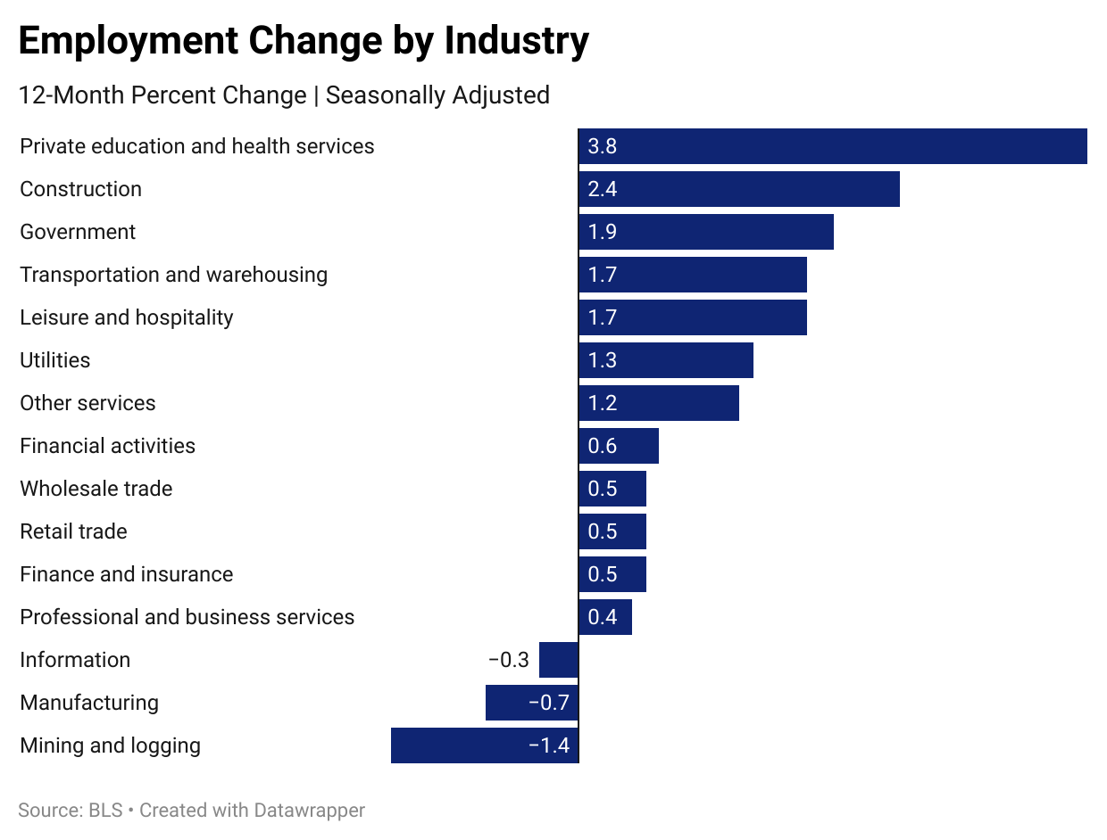
Private Education and Construction Sees the Largest Job Growth in 2024
Notes:
Private education and health services experienced the largest job growth this year. Strong increase formed mostly from health services which saw a 3.9% increase. The driving factor in this was home health care services (baby boomers increase the need for home healthcare services). Information and Manufacturing experiences job loss. Looking at Manufacturing, computer and electronic product manufacturing experienced the largest decrease for durable goods, while apparel experienced the largest decrease for nondurable goods.

Slide 21
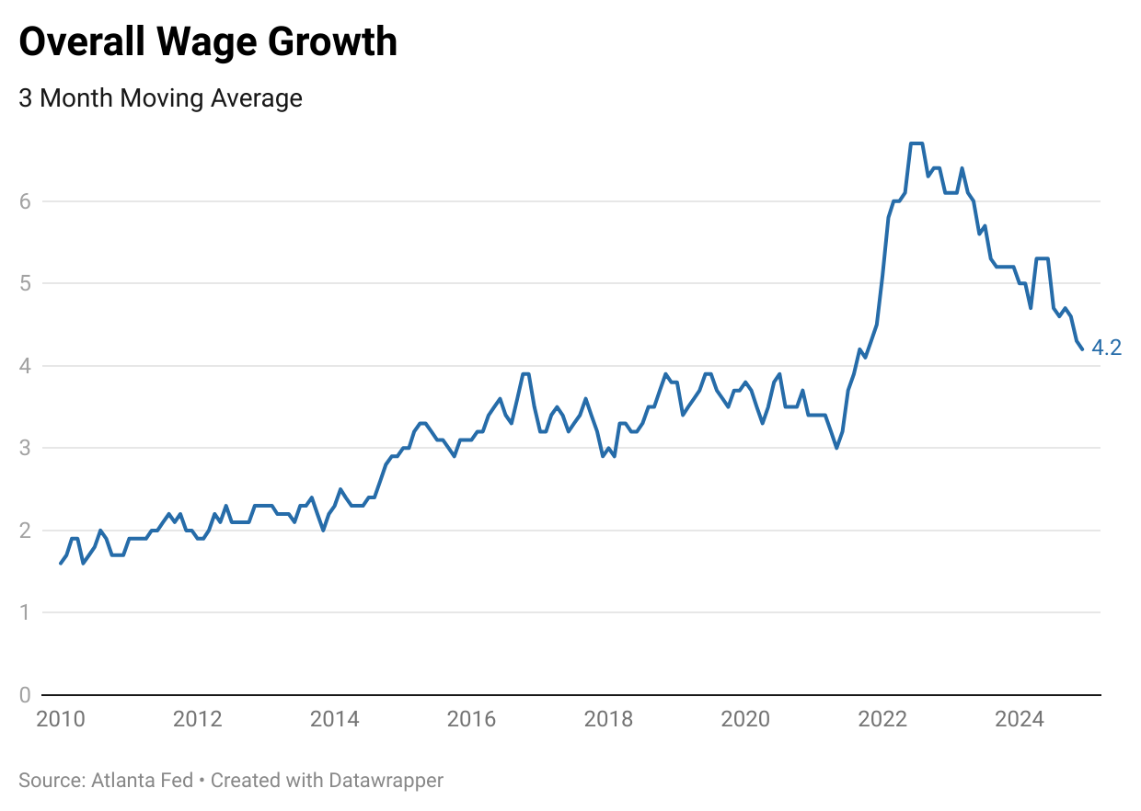
Overall Wage Growth has Decreased throughout 2024
Notes:
Wages and Benefit growth has slowed in 2024 after peaking in 2022

Slide 22
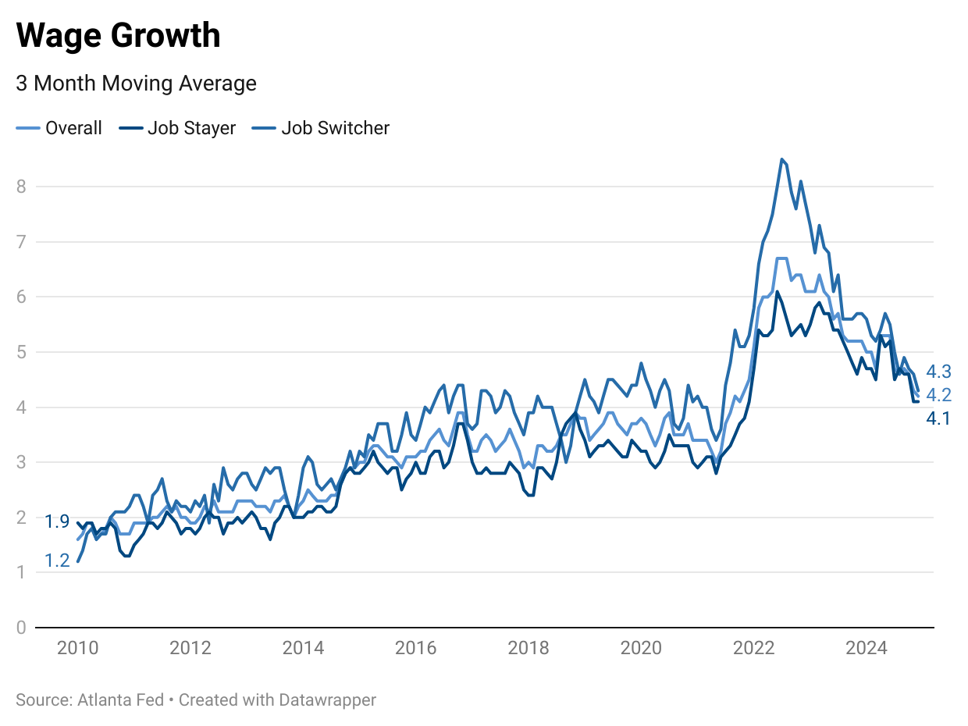
The Big Stay was Active throughout 2024 as Job Switchers No Longer Receive an Increase in Wage Growth
Notes:
Overtime there has been a small benefit to switch jobs. 2022 there was a large wage incentive to switch jobs compared to staying. Entering into 2025 we see that this incentive is gone as wage growth is nearly identical for job stayers and switchers.

Slide 23
Overview
1
Economic growth
The United States Economy grew at 2.8% in 2024. This moderate growth was driven through consumer spending specifically on services & durable goods. This stable growth is expected to continue into 2025
2
Labor Markets
The labor market continue to soften as unemployment was consistent at relatively low rates throughout the year. The labor force participation rate shows signs of a new normal.
3
Inflation
Global and domestic economic factors, including key indicators like housing, wages, supply chains and policy will determine future inflation trends and economic movements in 2025, but for now inflation is near target range, albeit slightly elevated
4
Housing
Housing prices likely to remain elevated in the midst of limited supply, vacancy, along with affordability challenges due to elevated mortgage rates.
5
The ”Known Unknowns”
Economy is on solid ground according to the Federal Reserve and monetary policy is in a holding pattern with rates in the face of the known unknowns
Fiscal and Trade policies are the key known unknowns that will play a role in shaping the economy in 2025

Slide 24
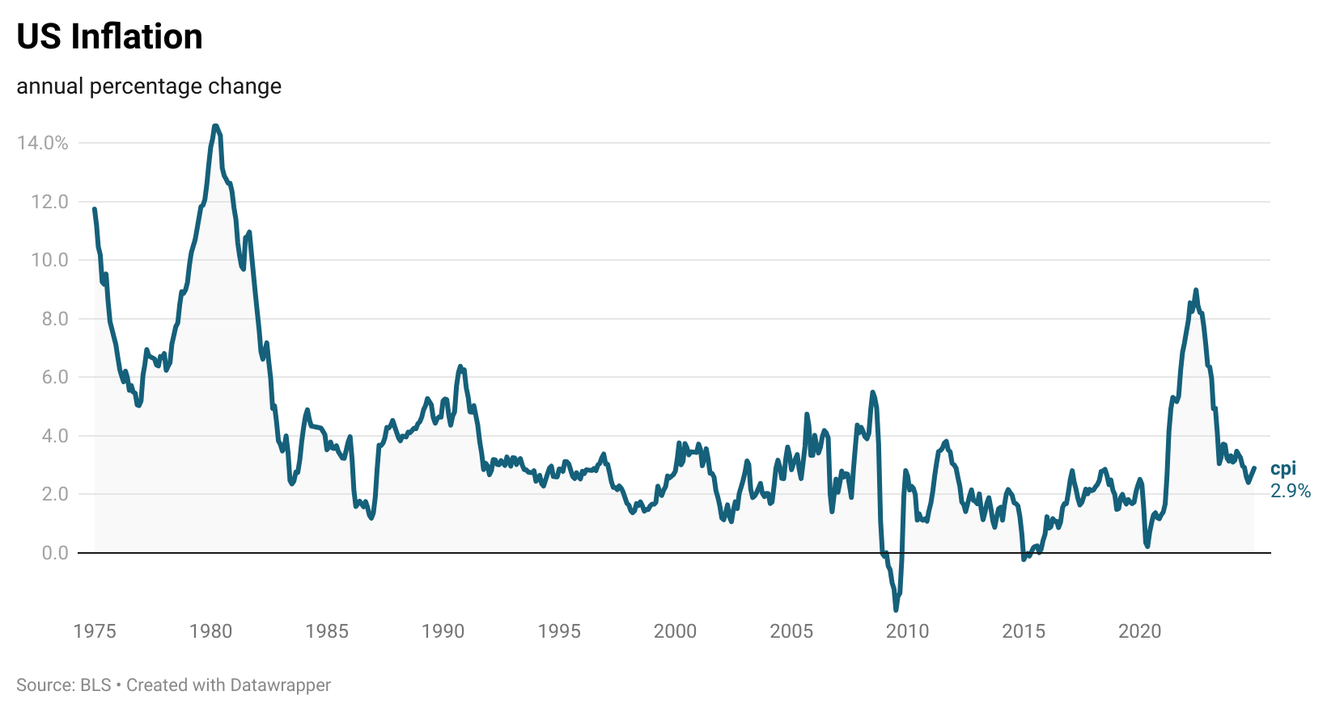
Inflation is down from recent highs, but hovering above pre-pandemic rates

Slide 25
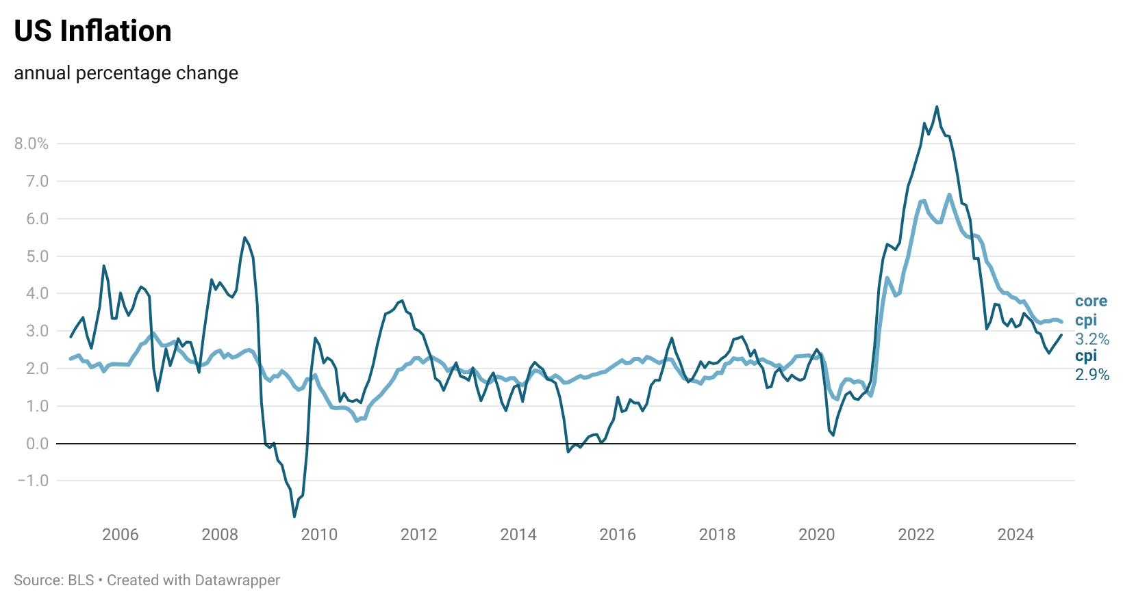
Core inflation (excluding food & energy) indicating slightly higher rates over the past year

Slide 26
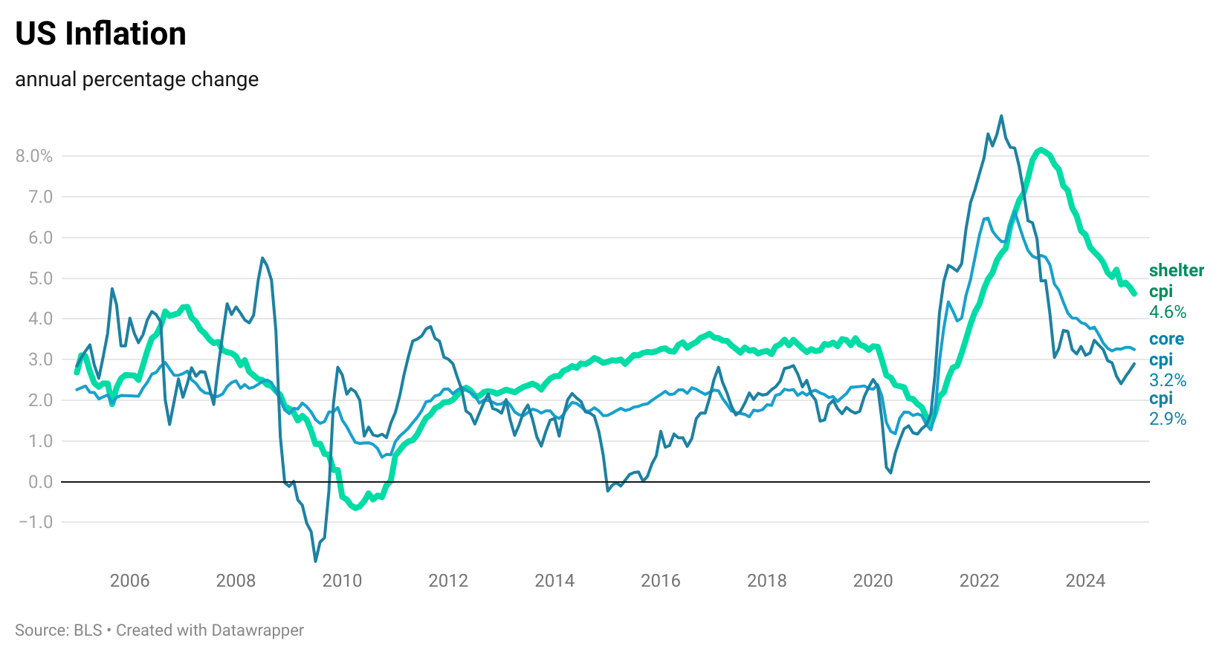
The “stickiness” and persistence of shelter inflation has been a challenge in brining rates down

Slide 27
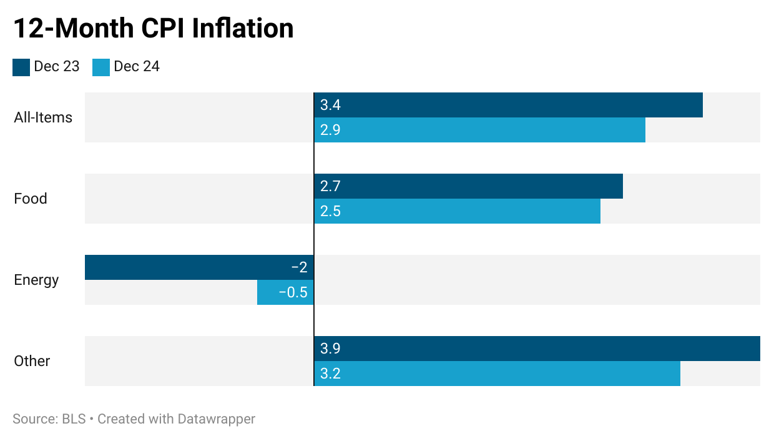
CPI Movers Show Less Changes in 2024, Each in Same Direction as 2023
Core

Slide 28
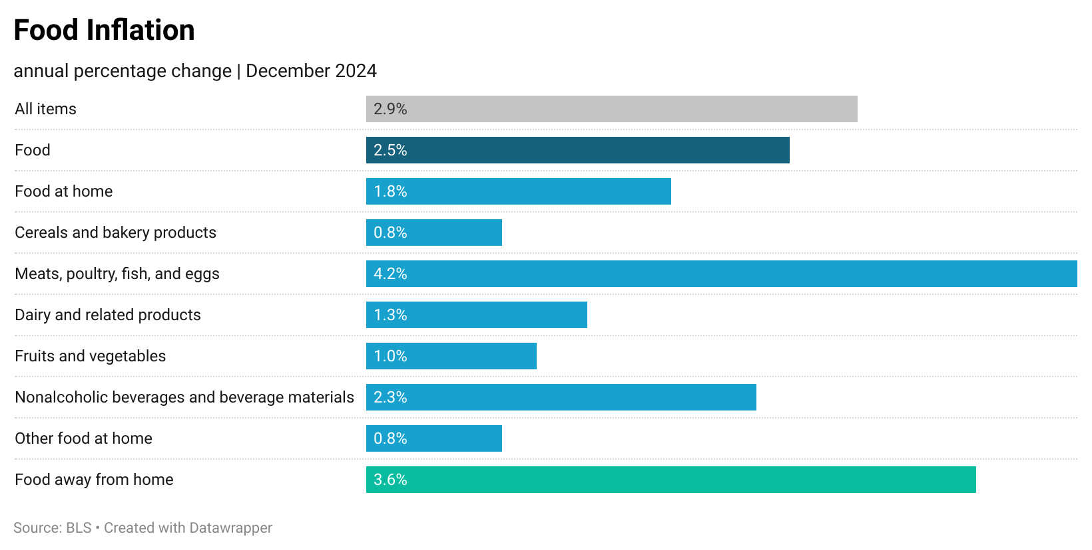
Food inflation trending slightly below over inflation at 2.5%, however, meat, poultry, fish, and eggs are still running well above trends

Slide 29
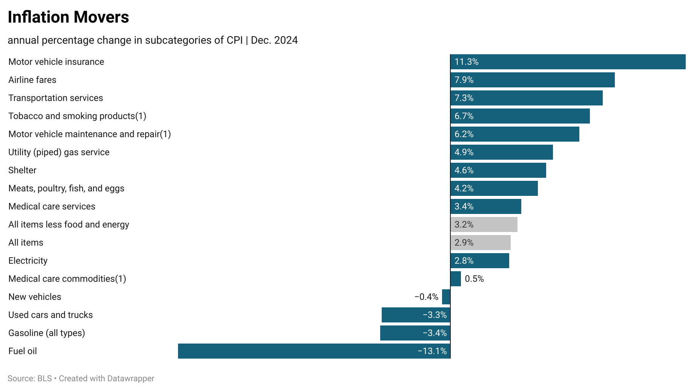

Slide 30
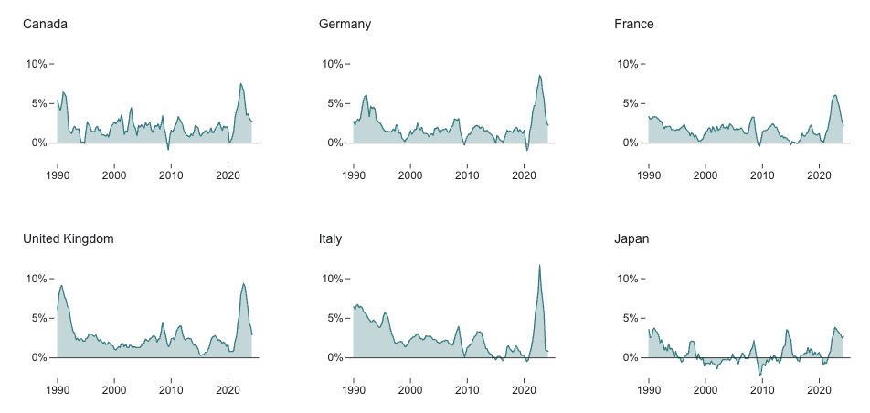
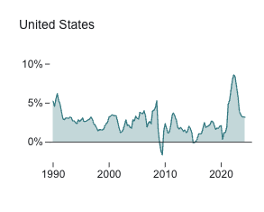
Inflation is not a US-centric phenomenon in recent years
Inflation in the G7
Source: Council of Foreign Relations

Slide 31
Overview
1
Economic growth
The United States Economy grew at 2.8% in 2024. This moderate growth was driven through consumer spending specifically on services & durable goods. This stable growth is expected to continue into 2025
2
Labor Markets
The labor market continue to soften as unemployment was consistent at relatively low rates throughout the year. The labor force participation rate shows signs of a new normal.
3
Inflation
Global and domestic economic factors, including key indicators like housing, wages, supply chains and policy will determine future inflation trends and economic movements in 2025, but for now inflation is near target range, albeit slightly elevated
4
Housing
Housing prices likely to remain elevated in the midst of limited supply, vacancy, along with affordability challenges due to elevated mortgage rates.
5
The ”Known Unknowns”
Economy is on solid ground according to the Federal Reserve and monetary policy is in a holding pattern with rates in the face of the known unknowns
Fiscal and Trade policies are the key known unknowns that will play a role in shaping the economy in 2025

Slide 32
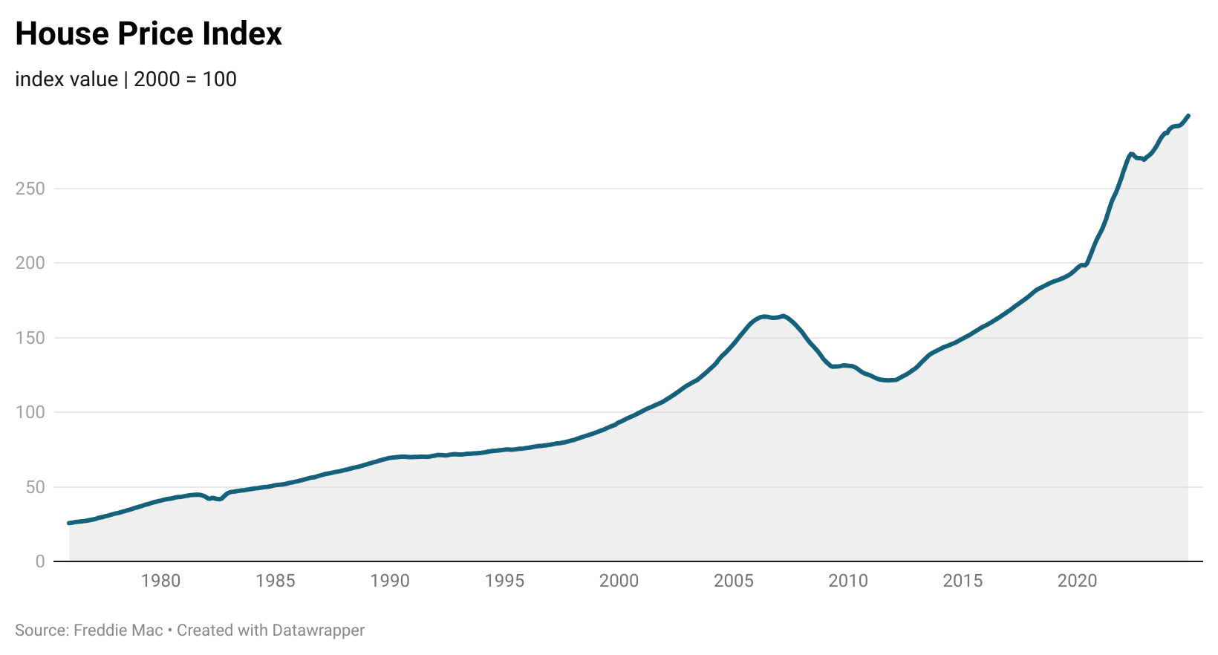
US home prices have experienced rapid increases in the past 4 years…

Slide 33
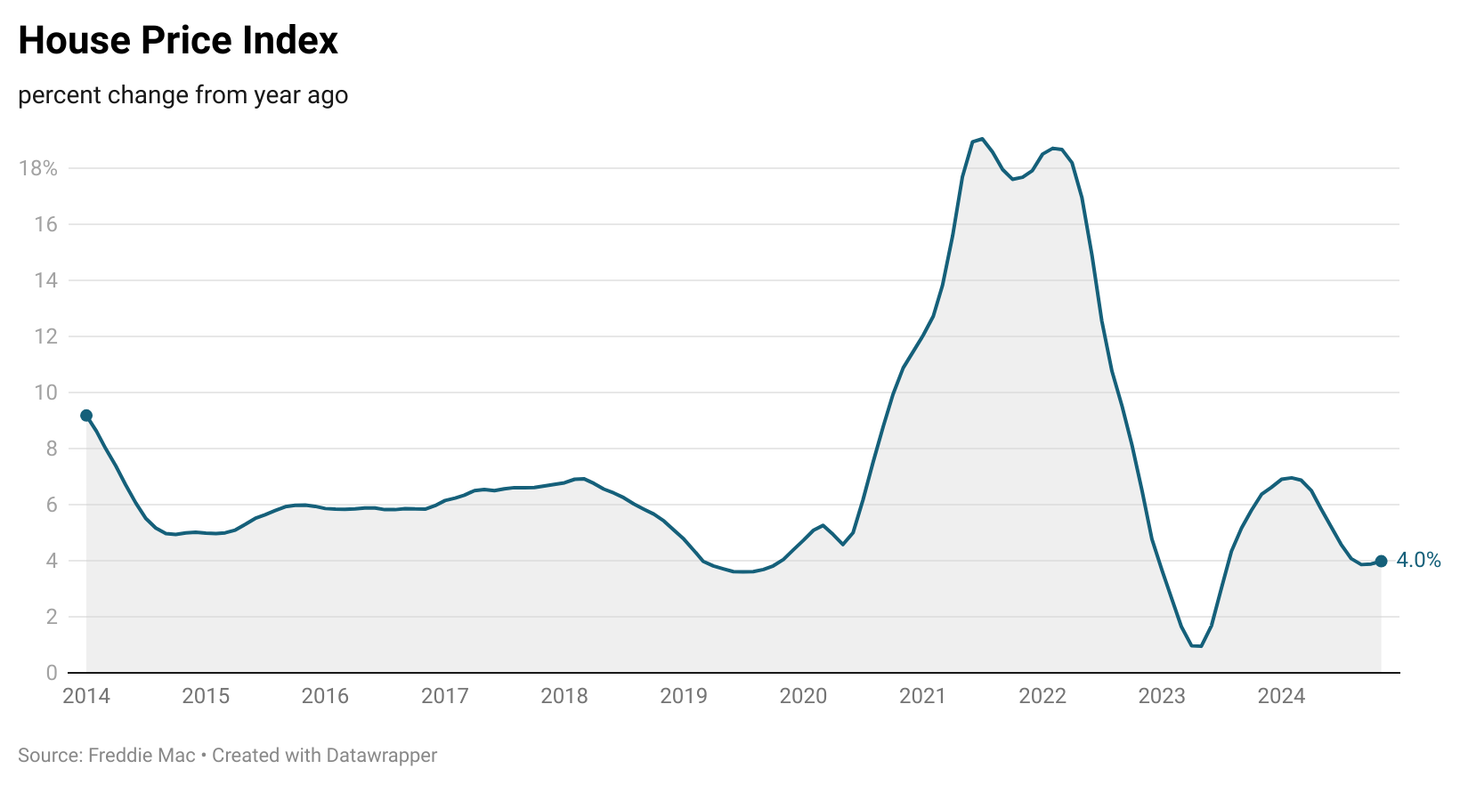
However, have slowed in the past year as buyers continue to “wait-and-see"

Slide 34
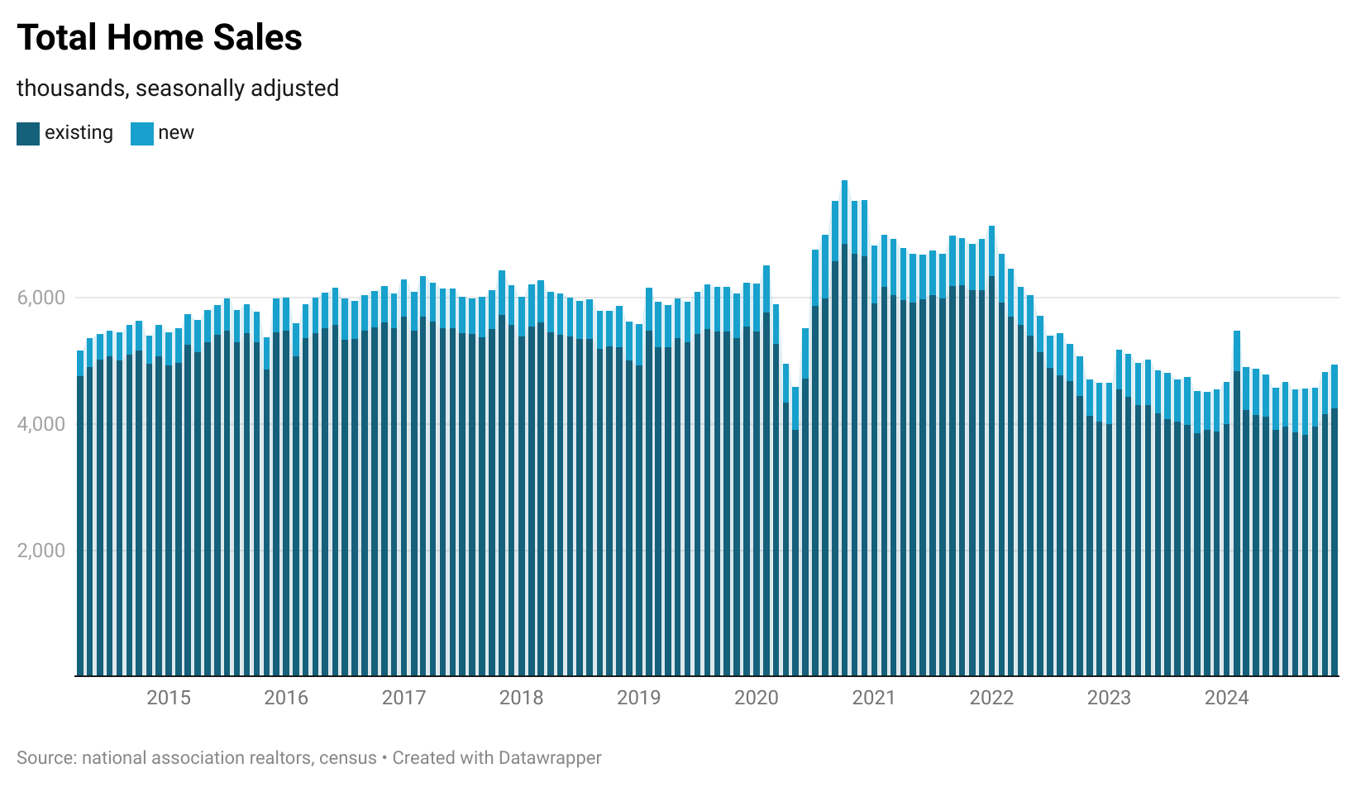
US home sales remain near multi-decade lows in the face of rising costs and reduced affordability
source: national association of realtors

Slide 35
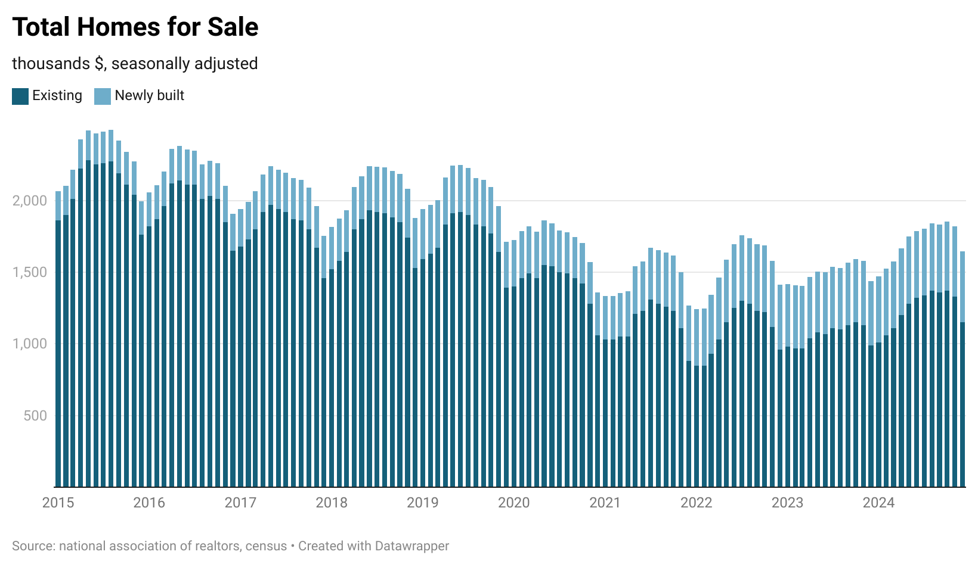
US housing supply also remains low, largely due to an undersupply of existing home sales

Slide 36
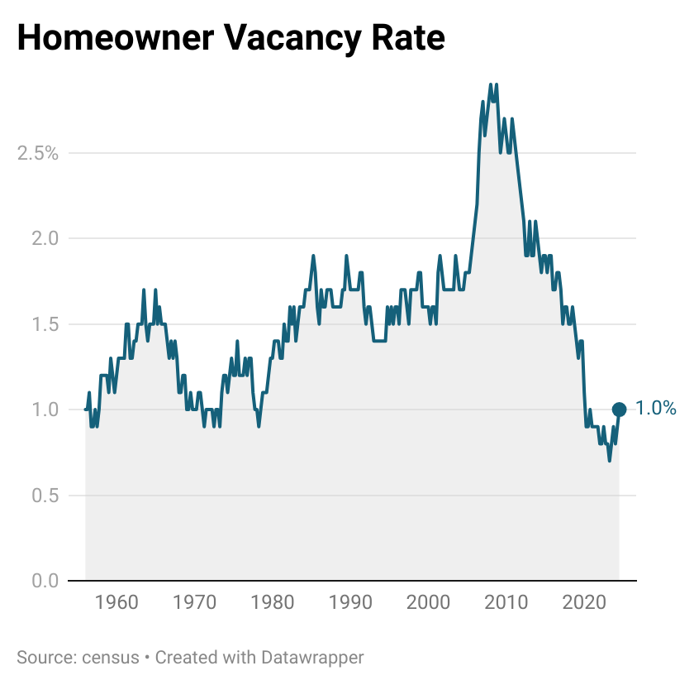
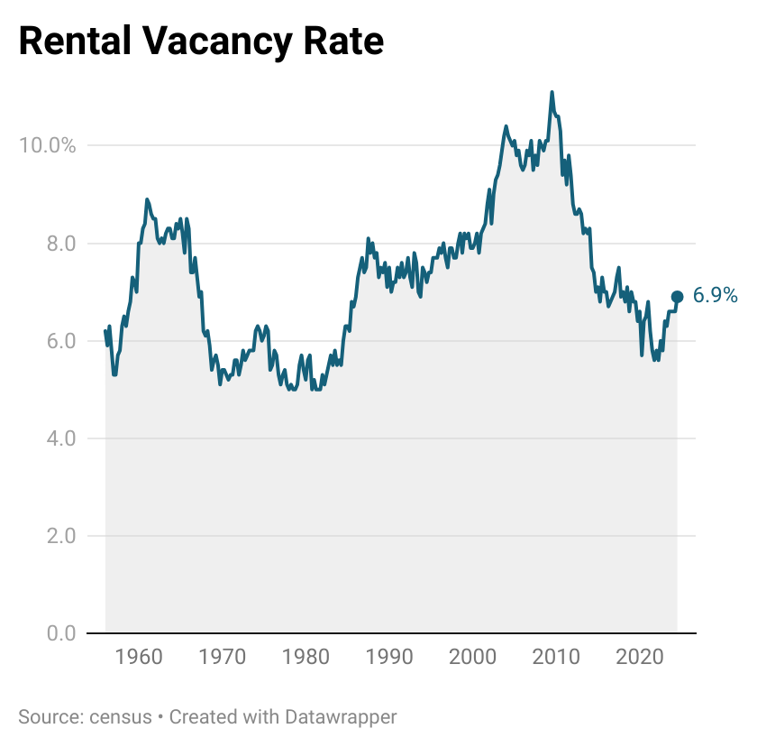
The limited housing supply has led to collapsing vacancy rates

Slide 37
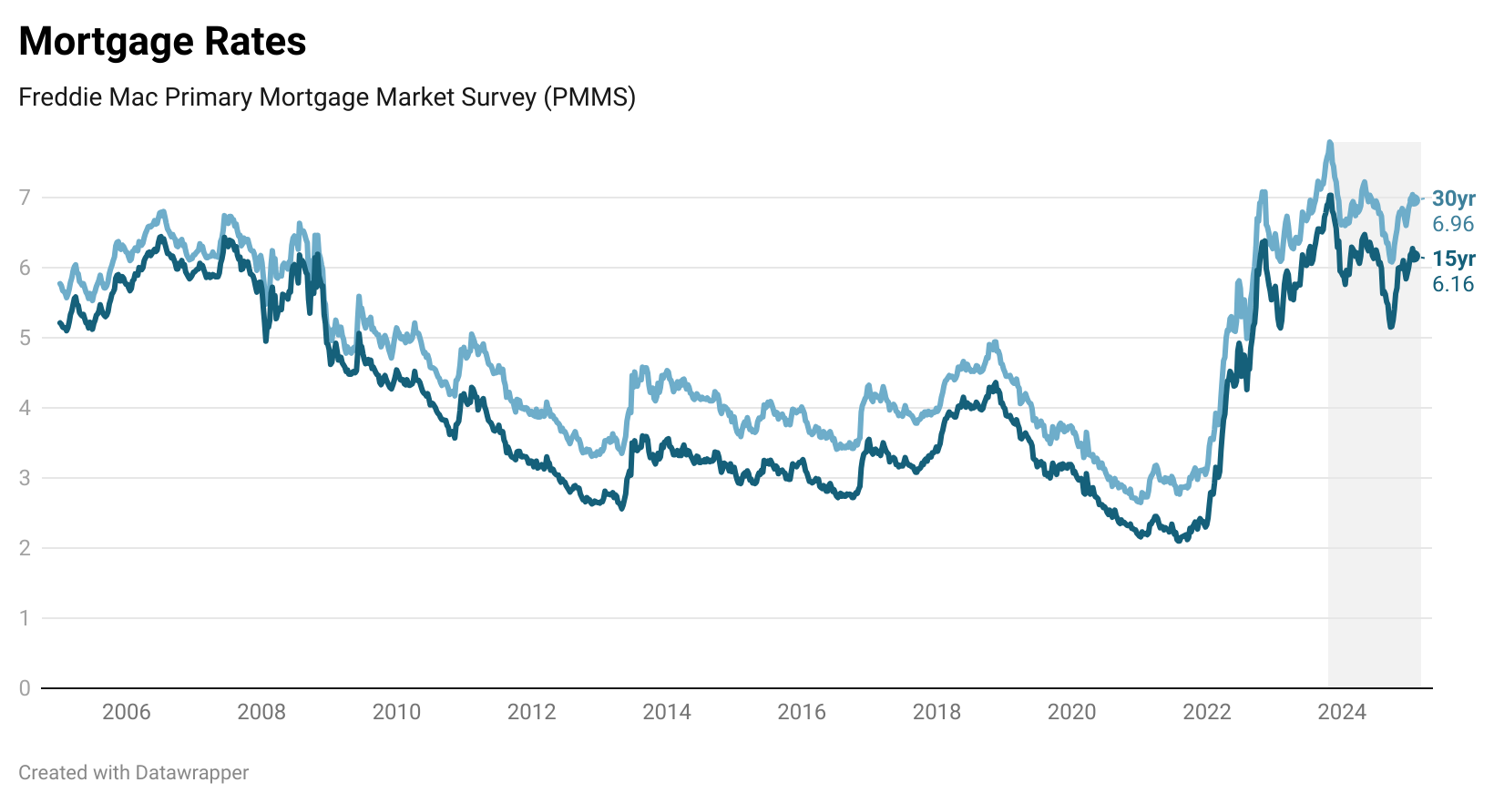
Mortgage rates decline alongside Federal Reserve rate cuts
source: freddie mac

Slide 38
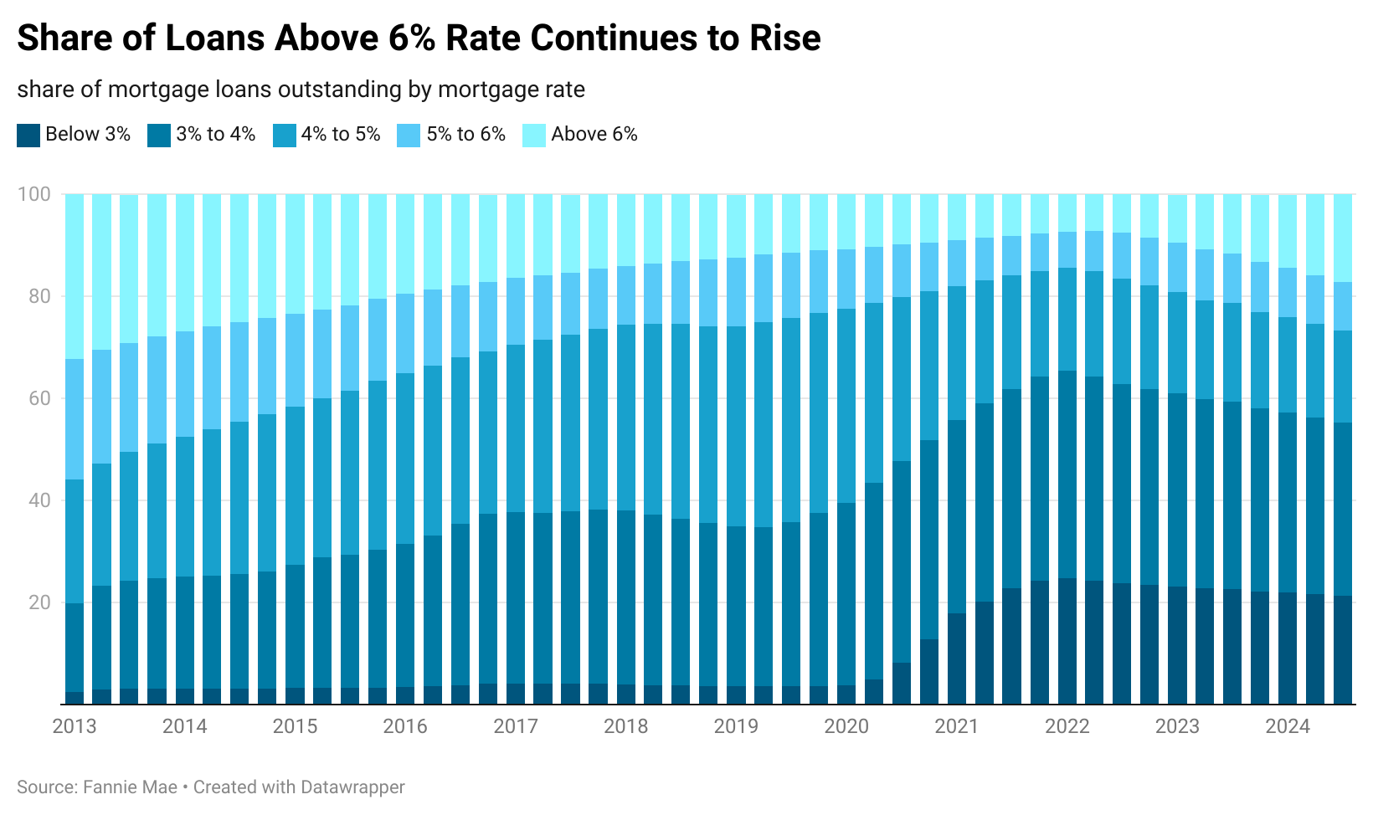
High Mortgage Rates Contribute to Unaffordability

Slide 39
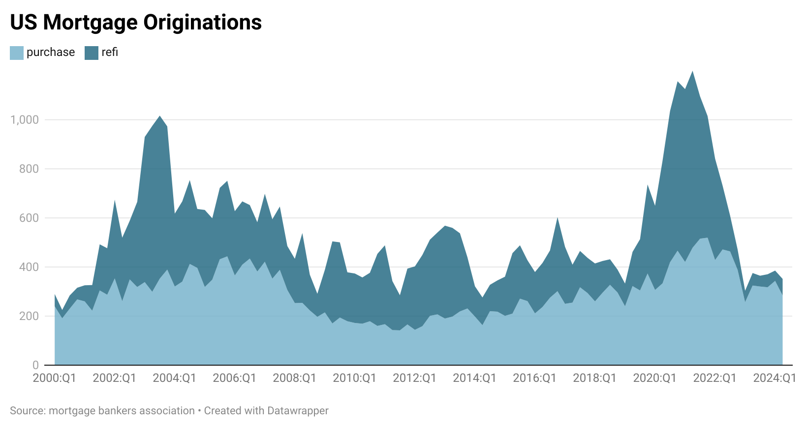
Mortgage originations are also near decade lows…

Slide 40
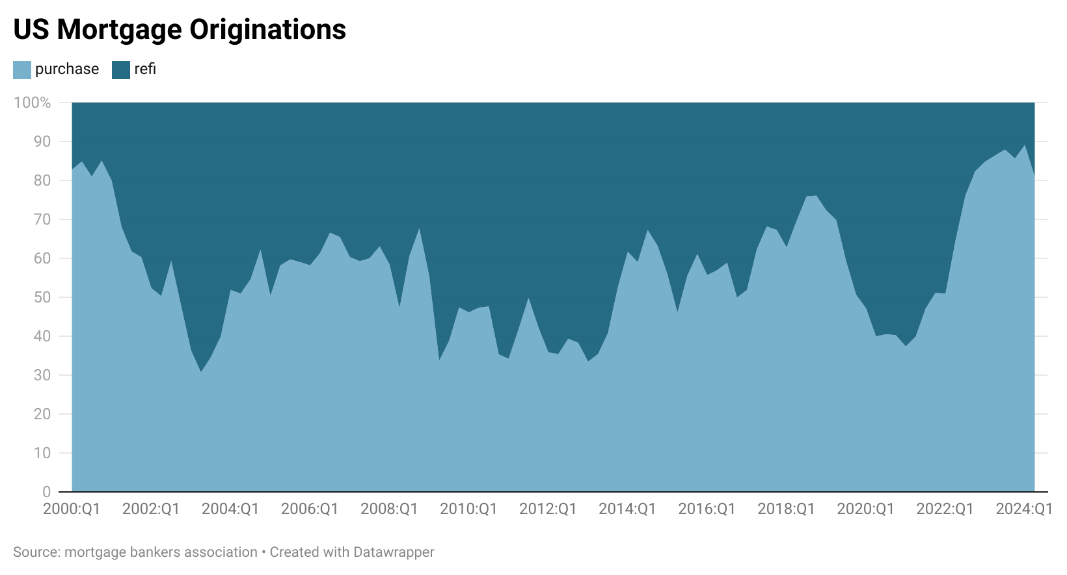
…due to a decline in refinancing

Slide 41
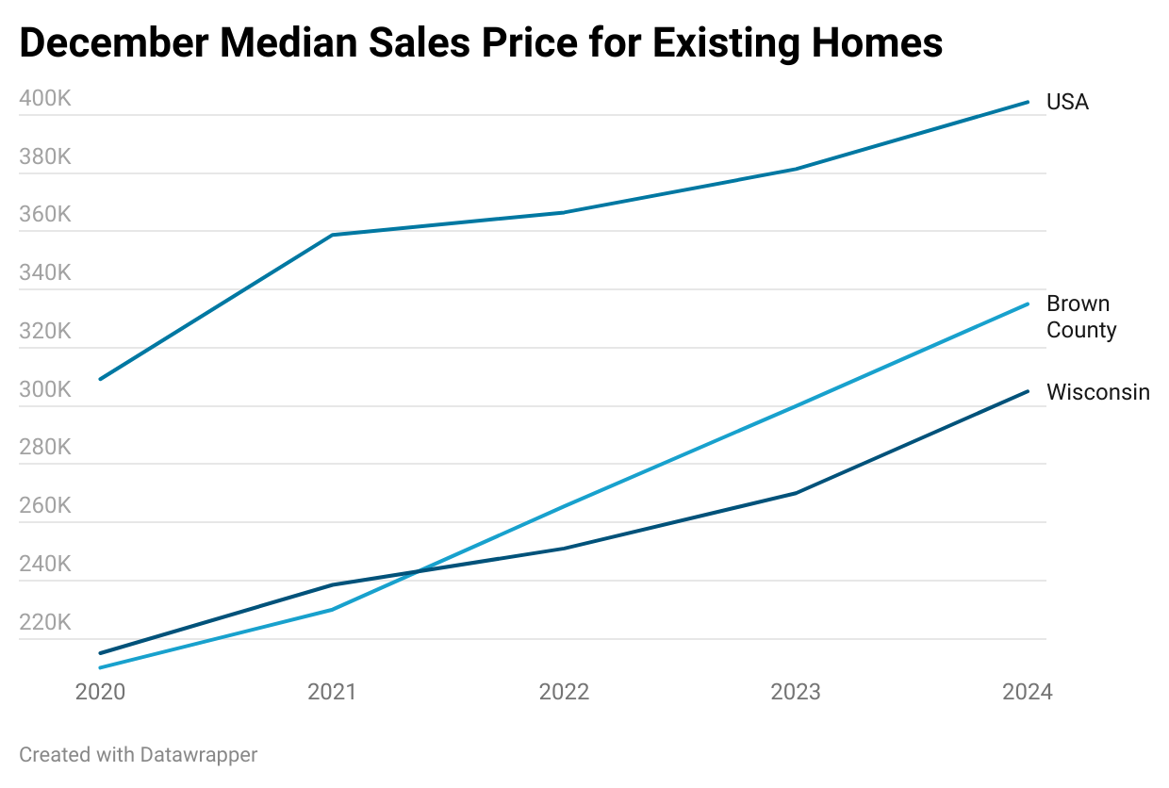
Brown County Prices Remain Relatively Low
USA:
$404,400
Brown: $335,000
WI:
$305,000
Notes:
I used listing prices here because they are comparable between the desired regions, this just means the asking price instead of the eventual buying price and isn’t all that directionally different for the nationwide data

Slide 42
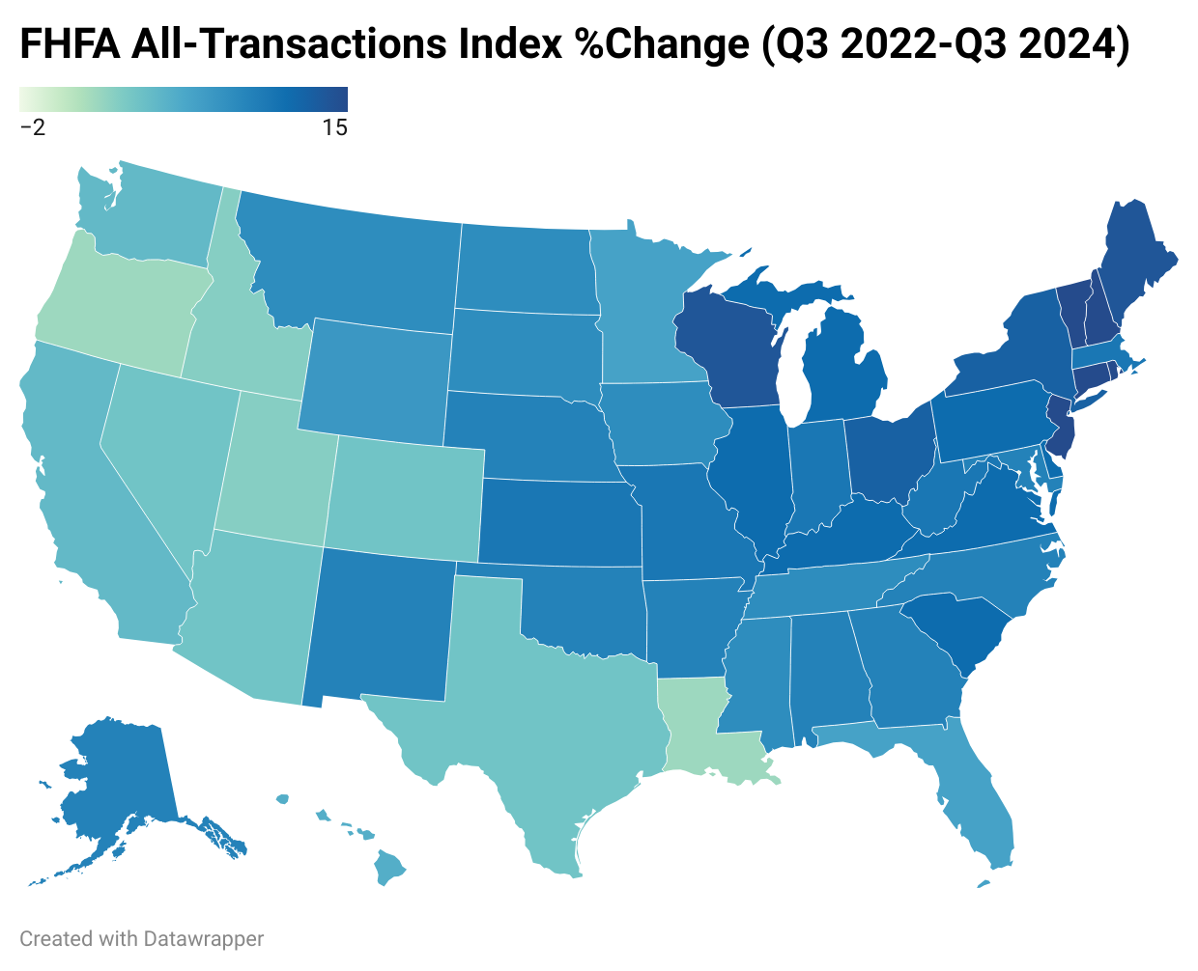
Shorter-Term Trends Highlight Midwest & Northeast Price Rises, West Coast Falls Behind
Notes:
If five years is too long I can change the comparison quarter/year
Find time frame of recent years, compare this map to a couple of years and how it changed over time. Compare coast has been growing over years, after hurricanes and wildfires hit that is when you see the midwest become larger
Percentage change will be much smaller in cali compared to wisconsin. Really affordable compared to other parts of the wisconsin
Potential add in gif- marc will at the end

Slide 43
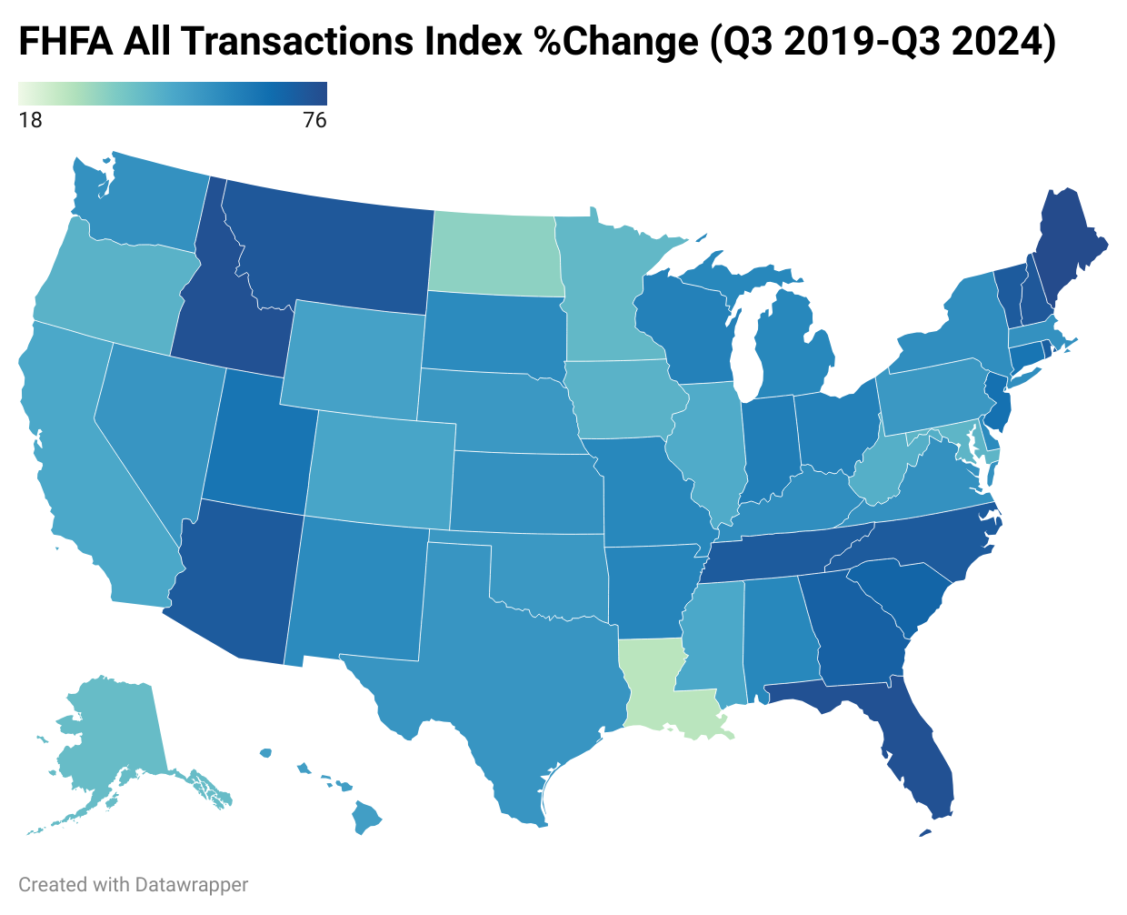
Long-term Trends Suggest Southeast and Far Northeast See Largest Increases, Midwest Growth Fairly High
Notes:
If five years is too long I can change the comparison quarter/year
Find time frame of recent years, compare this map to a couple of years and how it changed over time. Compare coast has been growing over years, after hurricanes and wildfires hit that is when you see the midwest become larger
Percentage change will be much smaller in cali compared to wisconsin. Really affordable compared to other parts of the wisconsin
Potential add in gif- marc will at the end

Slide 44
Overview
1
Economic growth
The United States Economy grew at 2.8% in 2024. This moderate growth was driven through consumer spending specifically on services & durable goods. This stable growth is expected to continue into 2025
2
Labor Markets
The labor market continue to soften as unemployment was consistent at relatively low rates throughout the year. The labor force participation rate shows signs of a new normal.
3
Inflation
Global and domestic economic factors, including key indicators like housing, wages, supply chains and policy will determine future inflation trends and economic movements in 2025, but for now inflation is near target range, albeit slightly elevated
4
Housing
Housing prices likely to remain elevated in the midst of limited supply, vacancy, along with affordability challenges due to elevated mortgage rates.
5
The ”Known Unknowns”
Economy is on solid ground according to the Federal Reserve and monetary policy is in a holding pattern with rates in the face of the known unknowns
Fiscal and Trade policies are the key known unknowns that will play a role in shaping the economy in 2025

Slide 45
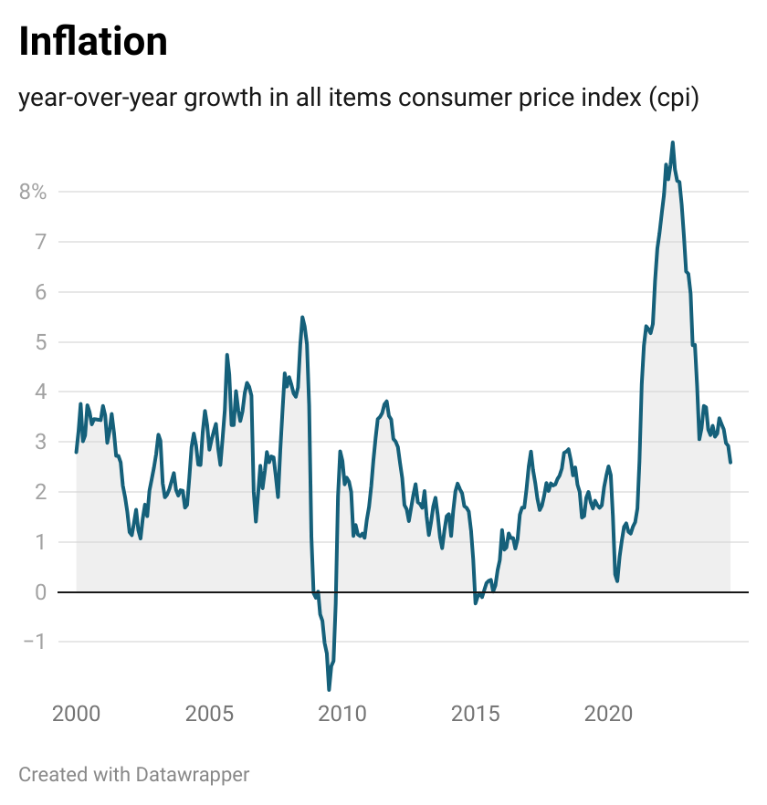
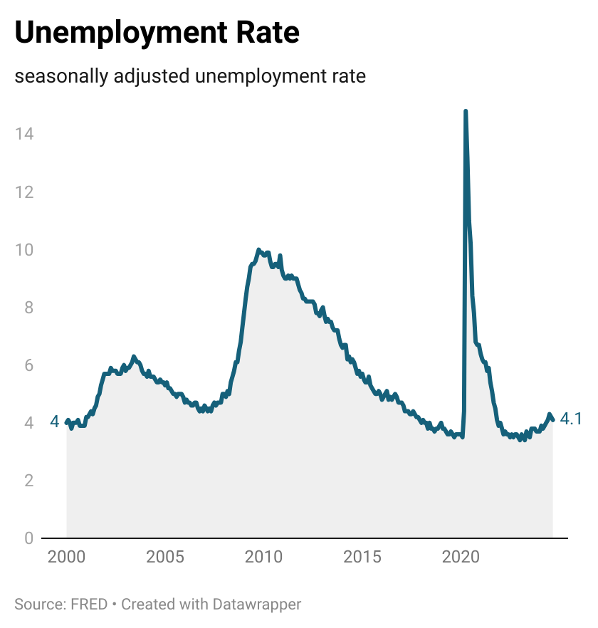
The balancing act of the Federal Reserve

Slide 46
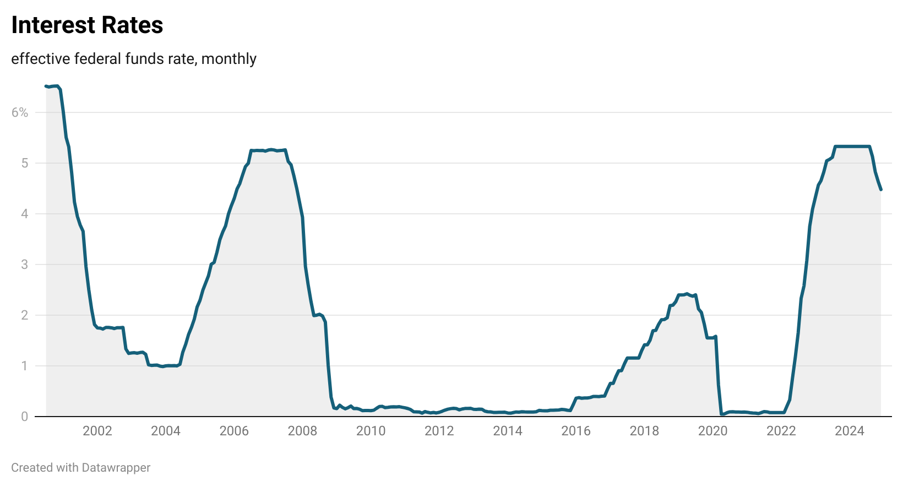
After a series of rate cuts in 2024, the Federal holds rates steady in January

Slide 47
FOMC in a holding pattern
“
The economy is strong overall and has made significant progress toward our goals over the past two years. Labor market conditions have cooled from their formerly overheated state and remain solid.
Inflation has moved much closer to our 2 percent longer-run goal, though it remains somewhat elevated.
In support of our goals, today the Federal Open Market Committee decided to leave our policy interest rate unchanged…”
Jerome Powell
January 29th, 2025

Slide 48
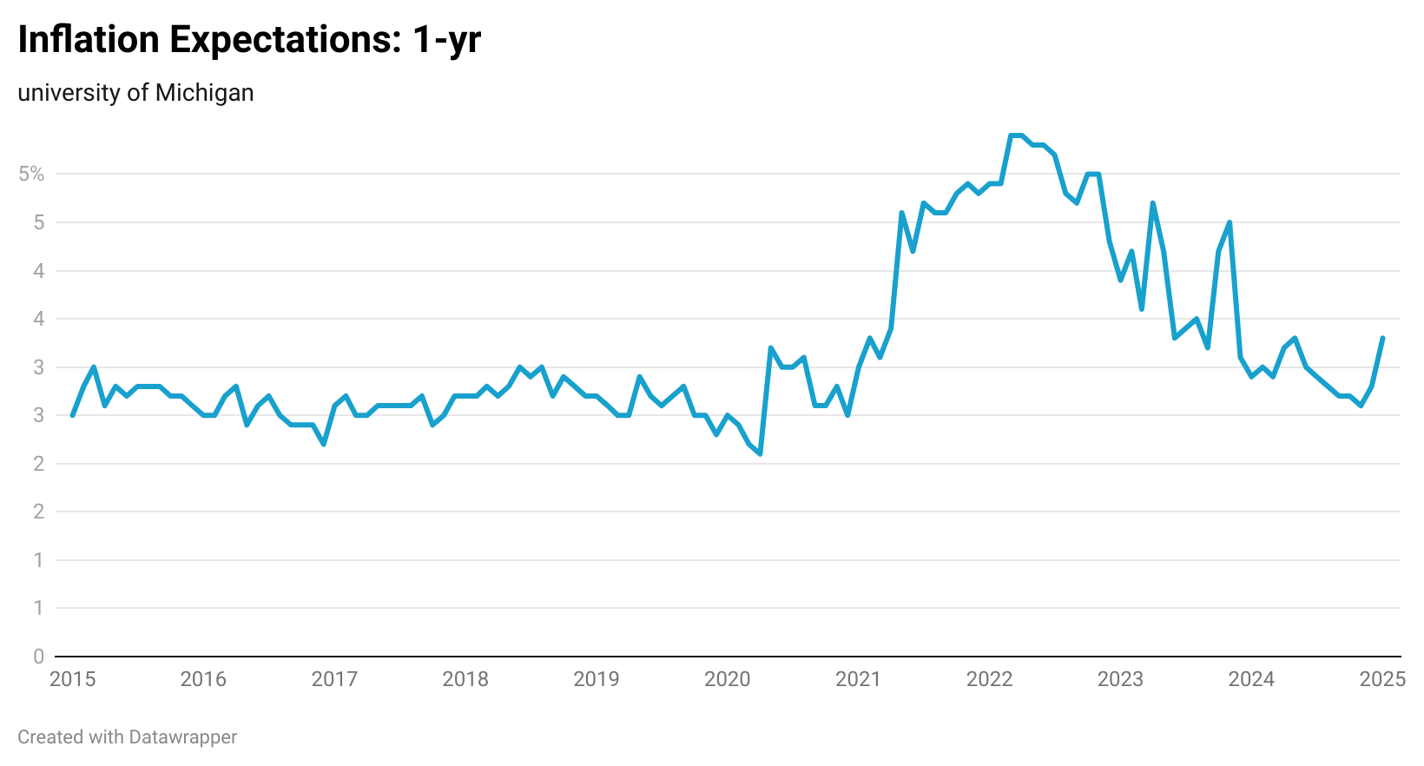
Is there concern about fiscal policy causing inflationary pressure…

Slide 49
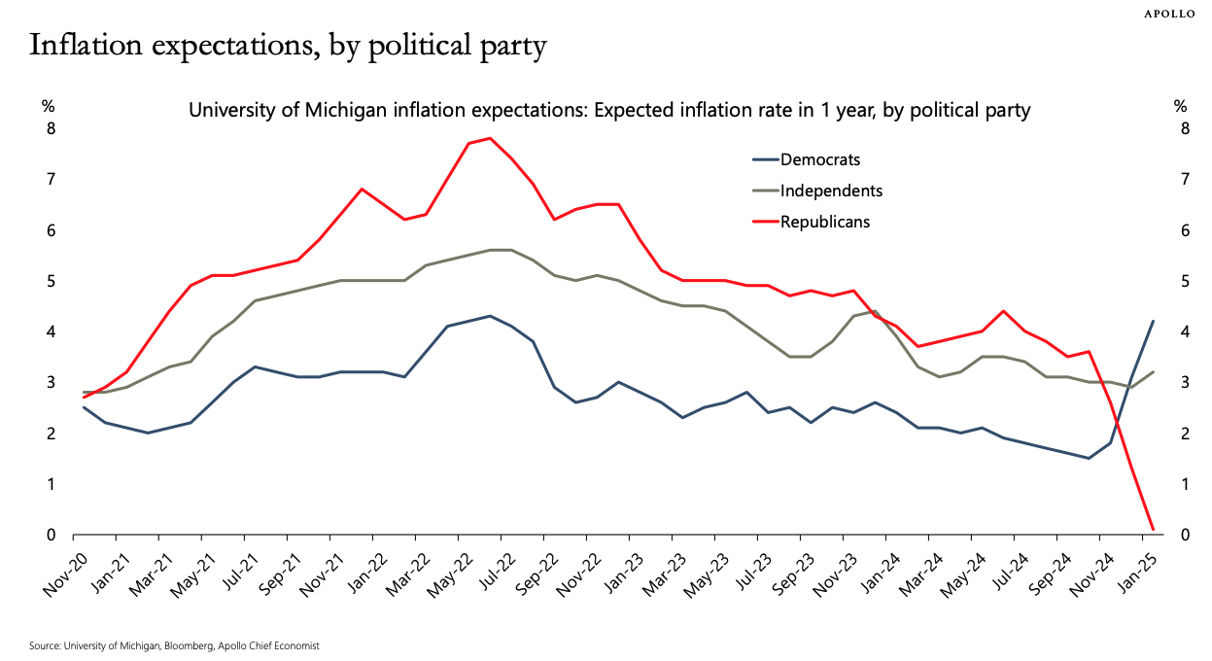
…it depends on who you ask

Slide 50
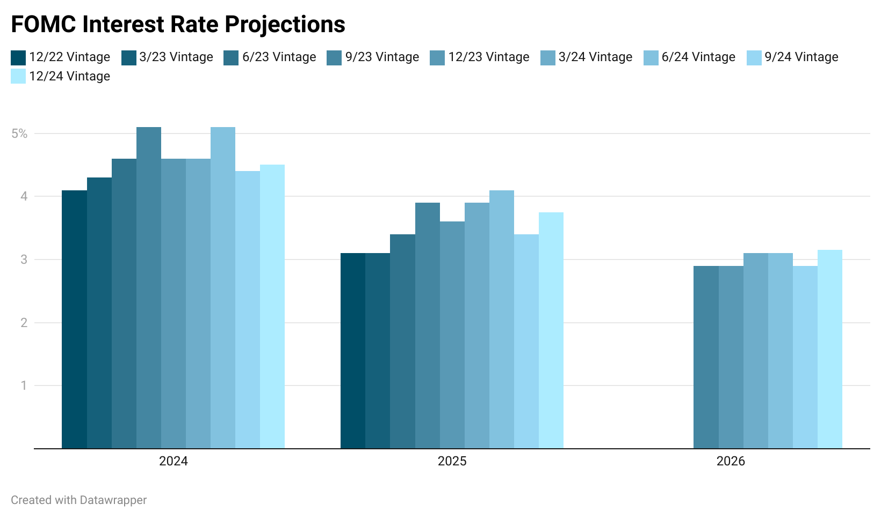
Although recent Fed meetings show some expectations of more stubborn rates

Slide 51
Overview
1
Economic growth
The United States Economy grew at 2.8% in 2024. This moderate growth was driven through consumer spending specifically on services & durable goods. This stable growth is expected to continue into 2025
2
Labor Markets
The labor market continue to soften as unemployment was consistent at relatively low rates throughout the year. The labor force participation rate shows signs of a new normal.
3
Inflation
Global and domestic economic factors, including key indicators like housing, wages, supply chains and policy will determine future inflation trends and economic movements in 2025, but for now inflation is near target range, albeit slightly elevated
4
Housing
Housing prices likely to remain elevated in the midst of limited supply, vacancy, along with affordability challenges due to elevated mortgage rates.
5
The ”Known Unknowns”
Economy is on solid ground according to the Federal Reserve and monetary policy is in a holding pattern with rates in the face of the known unknowns
Fiscal and Trade policies are the key known unknowns that will play a role in shaping the economy in 2025

Slide 52
Overview
1
Economic growth
The United States Economy grew at 2.8% in 2024. This moderate growth was driven through consumer spending specifically on services & durable goods. This stable growth is expected to continue into 2025
2
Labor Markets
The labor market continue to soften as unemployment was consistent at relatively low rates throughout the year. The labor force participation rate shows signs of a new normal.
3
Inflation
Global and domestic economic factors, including key indicators like housing, wages, supply chains and policy will determine future inflation trends and economic movements in 2025, but for now inflation is near target range, albeit slightly elevated
4
Housing
Housing prices likely to remain elevated in the midst of limited supply, vacancy, along with affordability challenges due to elevated mortgage rates.
5
The ”Known Unknowns”
Fiscal Policy Context

Slide 53
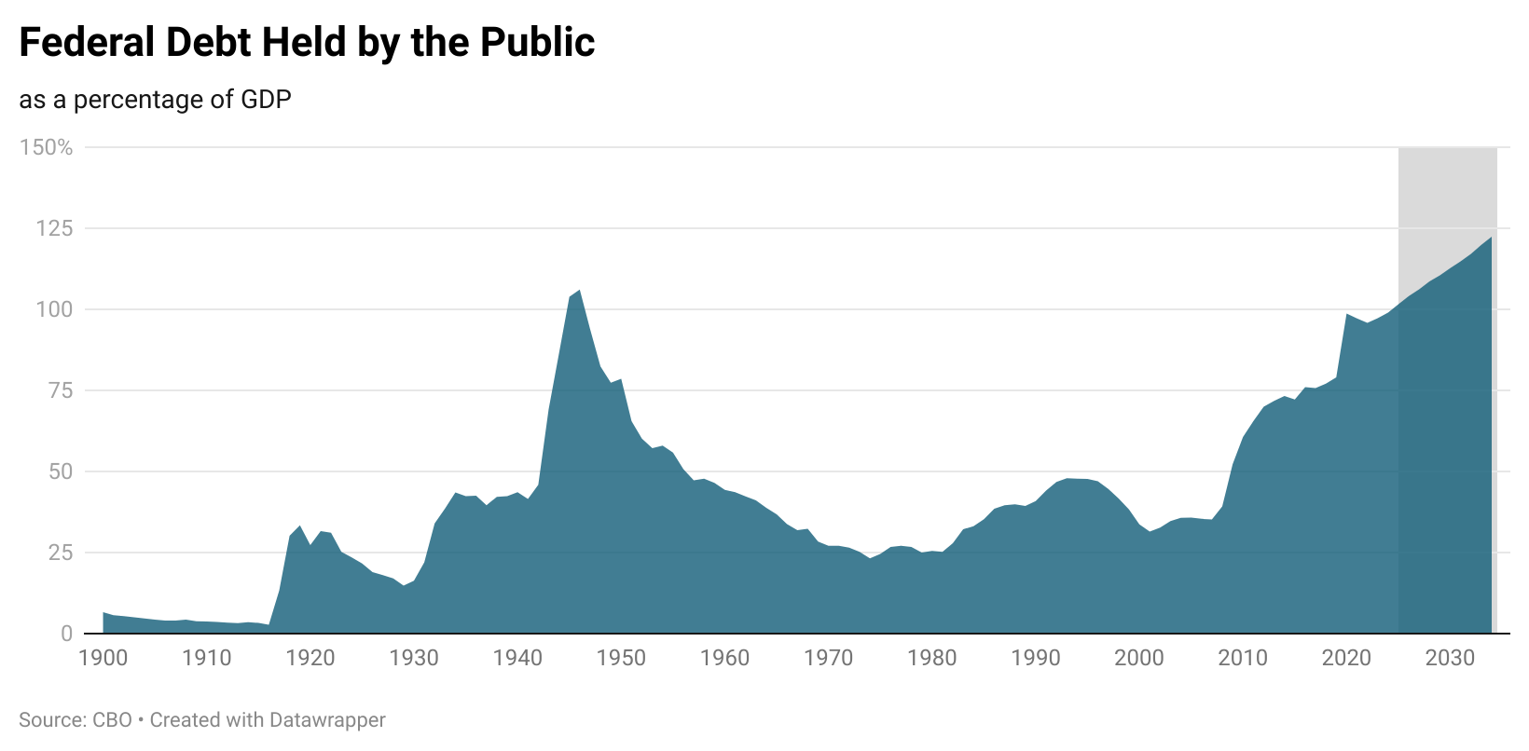
Federal debt continues to climb…

Slide 54
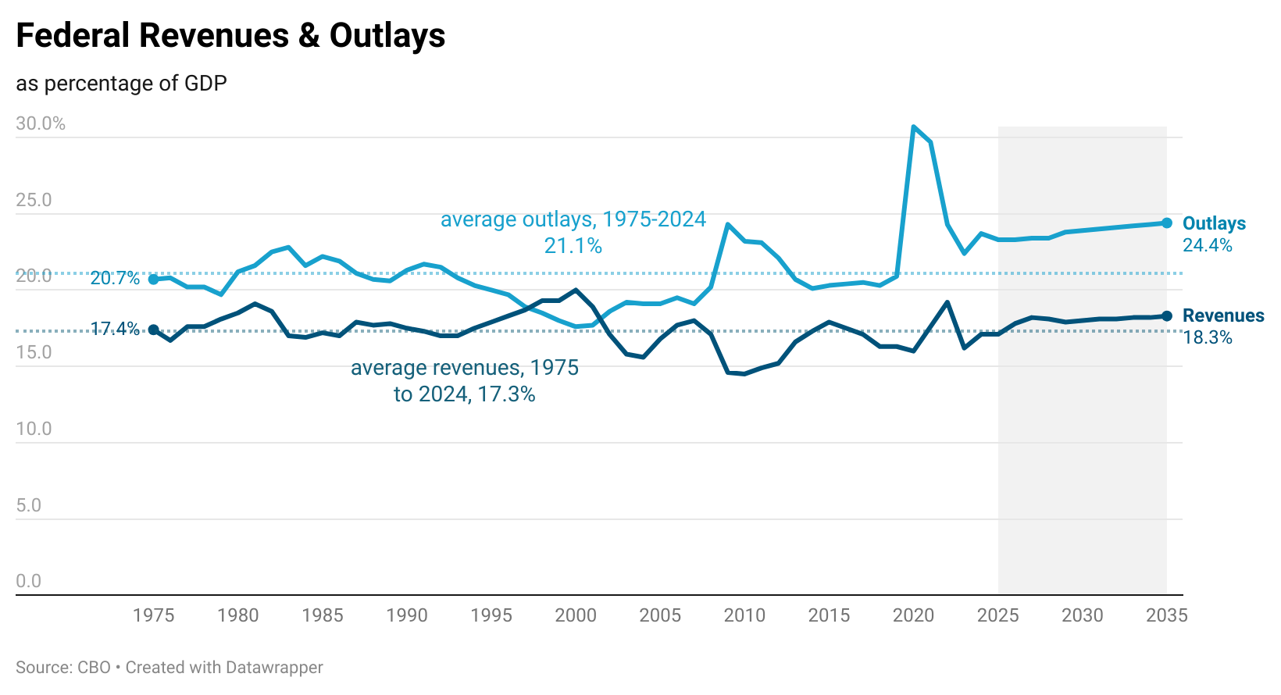
…this is not a new phenomenon
Congressional budget outlook
Notes:
2020: Both imports and exports dipped sharply during COVID-19, reflecting reduced global trade activity.
2021–2022: A widening gap as imports rebounded faster than exports, likely due to lingering tariff effects and a stronger domestic recovery.
2023–2024: A narrowing of the gap may indicate stabilizing trade policies and economic normalization.
2025: The trade gap could stabilize or narrow further if domestic production expands and tariff relaxations support balanced trade.

Slide 55
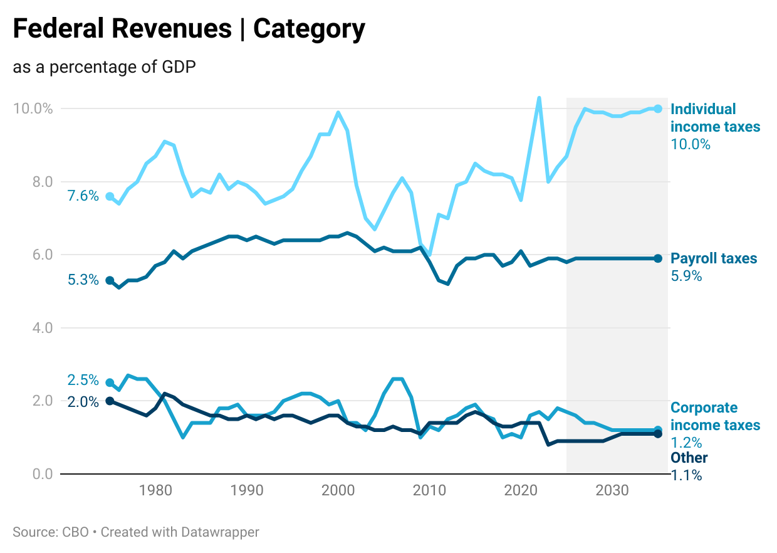
Revenues: Apart from income taxes, the trends are relatively consistent over time…policy will play a role here (?)
Congressional budget outlook

Slide 56
Outlays: Mandatory spending continues to drive outlays, with net interest adding increasing budgetary pressure
Notes:
2020: Both imports and exports dipped sharply during COVID-19, reflecting reduced global trade activity.
2021–2022: A widening gap as imports rebounded faster than exports, likely due to lingering tariff effects and a stronger domestic recovery.
2023–2024: A narrowing of the gap may indicate stabilizing trade policies and economic normalization.
2025: The trade gap could stabilize or narrow further if domestic production expands and tariff relaxations support balanced trade.

Slide 57
The most recent federal budget continued the trend with outlays exceeding revenues
$6.75 trillion
$4.9 trillion
Notes:
2020: Both imports and exports dipped sharply during COVID-19, reflecting reduced global trade activity.
2021–2022: A widening gap as imports rebounded faster than exports, likely due to lingering tariff effects and a stronger domestic recovery.
2023–2024: A narrowing of the gap may indicate stabilizing trade policies and economic normalization.
2025: The trade gap could stabilize or narrow further if domestic production expands and tariff relaxations support balanced trade.

Slide 58
Overview
1
Economic growth
The United States Economy grew at 2.8% in 2024. This moderate growth was driven through consumer spending specifically on services & durable goods. This stable growth is expected to continue into 2025
2
Labor Markets
The labor market continue to soften as unemployment was consistent at relatively low rates throughout the year. The labor force participation rate shows signs of a new normal.
3
Inflation
Global and domestic economic factors, including key indicators like housing, wages, supply chains and policy will determine future inflation trends and economic movements in 2025, but for now inflation is near target range, albeit slightly elevated
4
Housing
Housing prices likely to remain elevated in the midst of limited supply, vacancy, along with affordability challenges due to elevated mortgage rates.
5
The ”Known Unknowns”
Trade Policy Context

Slide 59
The US has consistently run trade deficits
Notes:
2020: Both imports and exports dipped sharply during COVID-19, reflecting reduced global trade activity.
2021–2022: A widening gap as imports rebounded faster than exports, likely due to lingering tariff effects and a stronger domestic recovery.
2023–2024: A narrowing of the gap may indicate stabilizing trade policies and economic normalization.
2025: The trade gap could stabilize or narrow further if domestic production expands and tariff relaxations support balanced trade.

Slide 60
However, these are really driven by goods, while the US runs trade surplus in services
Notes:
2020: Both imports and exports dipped sharply during COVID-19, reflecting reduced global trade activity.
2021–2022: A widening gap as imports rebounded faster than exports, likely due to lingering tariff effects and a stronger domestic recovery.
2023–2024: A narrowing of the gap may indicate stabilizing trade policies and economic normalization.
2025: The trade gap could stabilize or narrow further if domestic production expands and tariff relaxations support balanced trade.

Slide 61
Trade policy, Geopolitics, and transition to the new administration is top of mind
Notes:
-factories slow in April-May due to Lunar New Year, often closing due to lesser demands
-in effort to be prepared for holidays, August is the high point of shipping season
-conflicts near the Suez Canal and rising fuel costs reflect the steady incline between April and August

Slide 62
Trade policy, Geopolitics, and transition to the new administration is top of mind
Notes:
-factories slow in April-May due to Lunar New Year, often closing due to lesser demands
-in effort to be prepared for holidays, August is the high point of shipping season
-conflicts near the Suez Canal and rising fuel costs reflect the steady incline between April and August

Slide 63
Tariff challenges: retaliation
Source: Fajgelbaum et. al (2019), NBER Working Paper
Notes:
2020: Both imports and exports dipped sharply during COVID-19, reflecting reduced global trade activity.
2021–2022: A widening gap as imports rebounded faster than exports, likely due to lingering tariff effects and a stronger domestic recovery.
2023–2024: A narrowing of the gap may indicate stabilizing trade policies and economic normalization.
2025: The trade gap could stabilize or narrow further if domestic production expands and tariff relaxations support balanced trade.

Slide 64
Tariff challenges: retaliation
Source: Fajgelbaum et. al (2019), NBER Working Paper
Notes:
2020: Both imports and exports dipped sharply during COVID-19, reflecting reduced global trade activity.
2021–2022: A widening gap as imports rebounded faster than exports, likely due to lingering tariff effects and a stronger domestic recovery.
2023–2024: A narrowing of the gap may indicate stabilizing trade policies and economic normalization.
2025: The trade gap could stabilize or narrow further if domestic production expands and tariff relaxations support balanced trade.

Slide 65
Overview
1
Economic growth
The United States Economy grew at 2.8% in 2024. This moderate growth was driven through consumer spending specifically on services & durable goods. This stable growth is expected to continue into 2025
2
Labor Markets
The labor market continue to soften as unemployment was consistent at relatively low rates throughout the year. The labor force participation rate shows signs of a new normal.
3
Inflation
Global and domestic economic factors, including key indicators like housing, wages, supply chains and policy will determine future inflation trends and economic movements in 2025, but for now inflation is near target range, albeit slightly elevated
4
Housing
Housing prices likely to remain elevated in the midst of limited supply, vacancy, along with affordability challenges due to elevated mortgage rates.
5
The ”Known Unknowns”
Economy is on solid ground according to the Federal Reserve and monetary policy is in a holding pattern with rates in the face of the known unknowns
Fiscal and Trade policies are the key known unknowns that will play a role in shaping the economy in 2025

Slide 66
Short Run Known Unknowns: A Policy Perspective
1
Taxes: Tax Cuts & Jobs Act Expiring?
Government Spending: DOGE & Funding Freeze
Immigration Policy: Labor market impacts?
Tariff Policy: what is the actual policy that will get implemented?
Economic Uncertainty: other economic factors
Fed Policy: Holding to respond as needed to inflation and labor market effects
2
3
4
5
6
Notes:
-factories slow in April-May due to Lunar New Year, often closing due to lesser demands
-in effort to be prepared for holidays, August is the high point of shipping season
-conflicts near the Suez Canal and rising fuel costs reflect the steady incline between April and August

Slide 67
Navigating the “Known Unknowns”
1
Economic growth
The United States Economy grew at 2.8% in 2024. This moderate growth was driven through consumer spending specifically on services & durable goods. This stable growth is expected to continue into 2025
2
Labor Markets
The labor market continue to soften as unemployment was consistent at relatively low rates throughout the year. The labor force participation rate shows signs of a new normal.
3
Inflation
Global and domestic economic factors, including key indicators like housing, wages, supply chains and policy will determine future inflation trends and economic movements in 2025, but for now inflation is near target range, albeit slightly elevated
4
Housing
Housing prices likely to remain elevated in the midst of limited supply, vacancy, along with affordability challenges due to elevated mortgage rates.
5
The ”Known Unknowns”
Economy is on solid ground according to the Federal Reserve and monetary policy is in a holding pattern with rates in the face of the known unknowns
Fiscal and Trade policies are the key known unknowns that will play a role in shaping the economy in 2025

